Slide 1
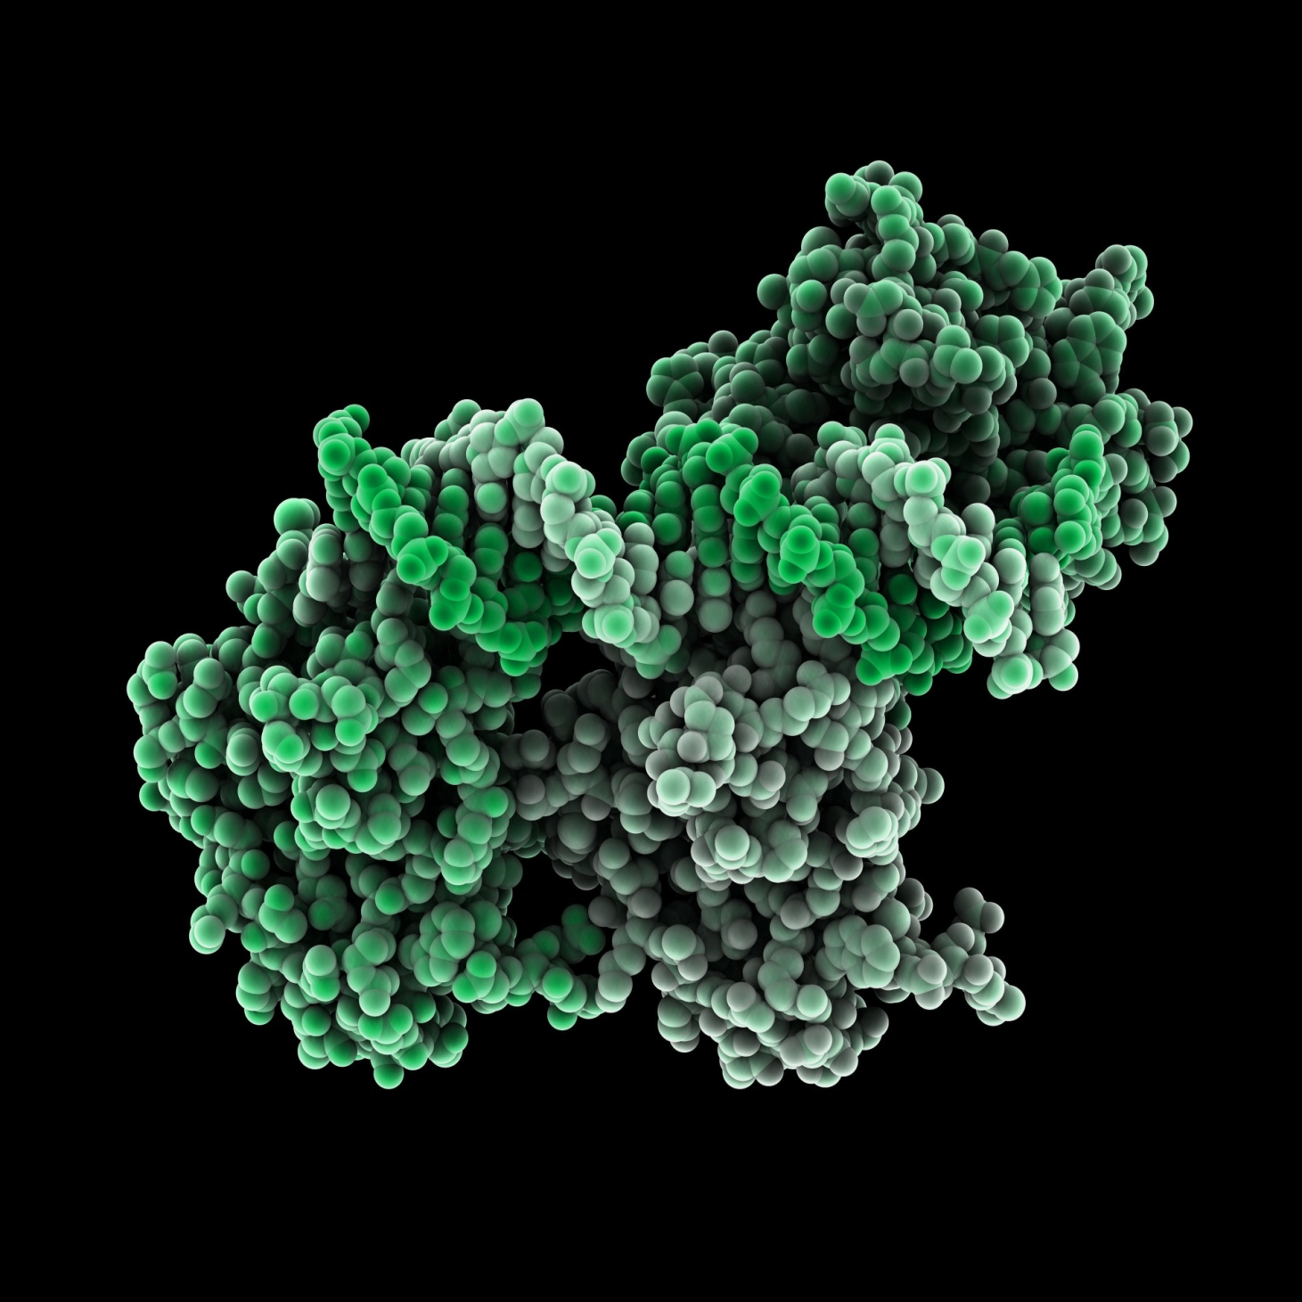


Kinase Assay Technologies & Overview of SignalChem Assay Platforms
Eric Yao
Sr. Scientist & Team lead, Assay Dev.
Sino Biological/SignalChem Biotech
September 2024

Slide 2
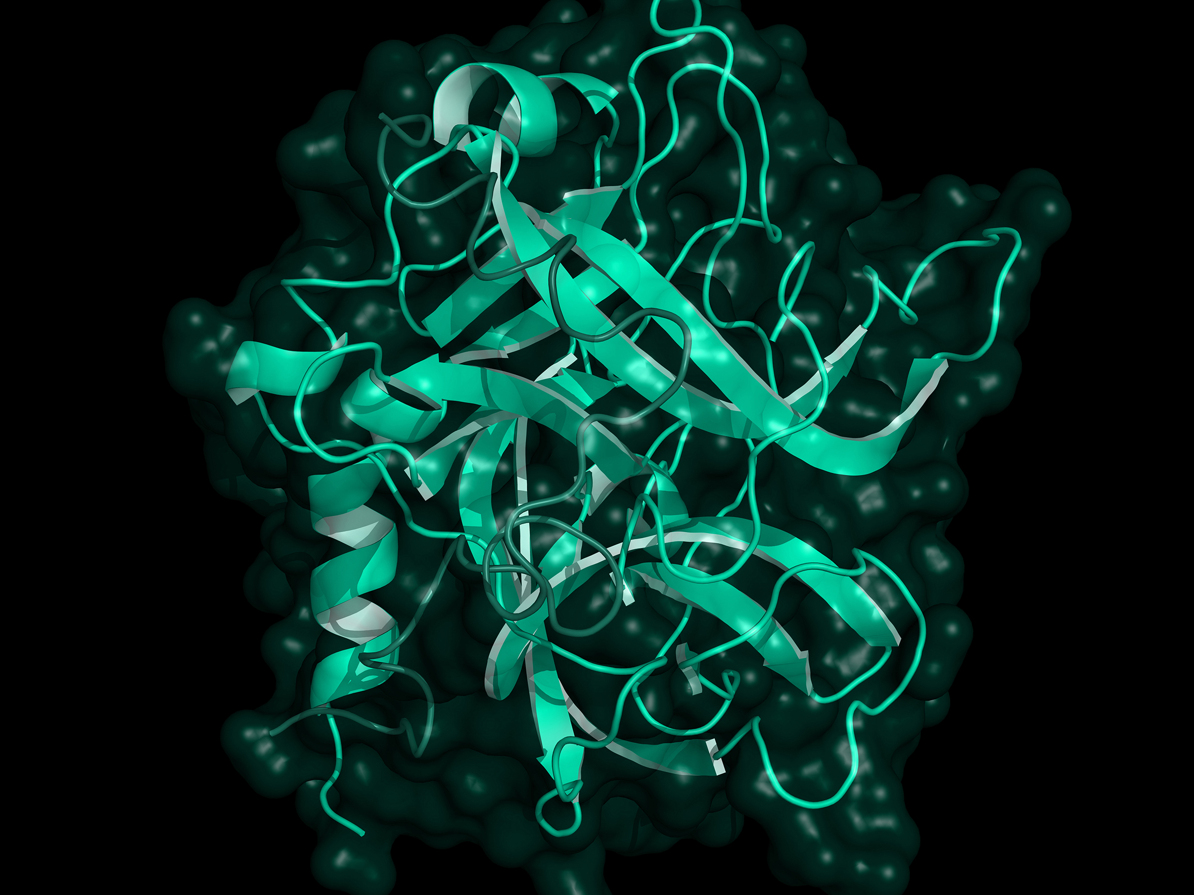


CONTENT
1
Kinase biochemistry and functions
2
Kinase as an important drug target class
3
Kinase assay technologies
4
SignalChem assay platforms and kinase assay case studies
Sino Biological, Inc.

Slide 3
01
Kinase biochemistry and functions
Sino Biological, Inc.

Slide 4

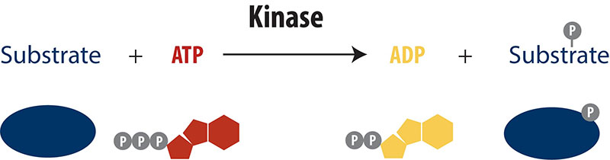
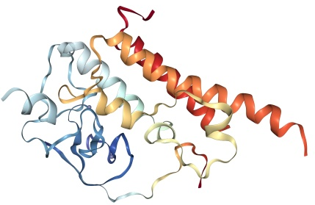
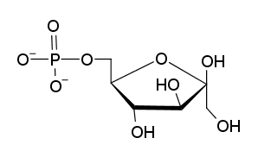
Kinases catalyze substrate phosphorylation
Proteins
Lipids
Carbohydrates
4
Sino Biological, Inc.
Notes:
Protein kinase - cell signaling （cell proliferation, survival and migration）
lipid kinase - controlling the molecular composition of membranes in cells, which helps to specify the physical and chemical properties of the different membranes
Carbohydrate kinase – energy metabolism
→Protein kinases are one of the largest families of evolutionarily related proteins and comprise one of the most abundant gene families in humans

Slide 5
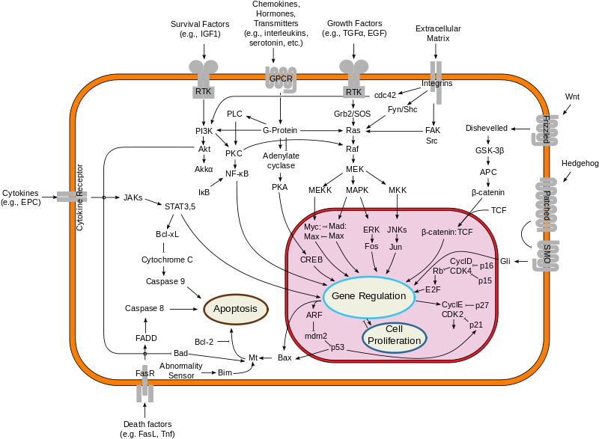
Kinase signaling controls cellular activities
Over-production of ligand
Mutation
Overexpression
5
Sino Biological, Inc.
Image: https://en.wikipedia.org/wiki/Kinase

Slide 6
02
Kinase as an important drug target class
Sino Biological, Inc.

Slide 7
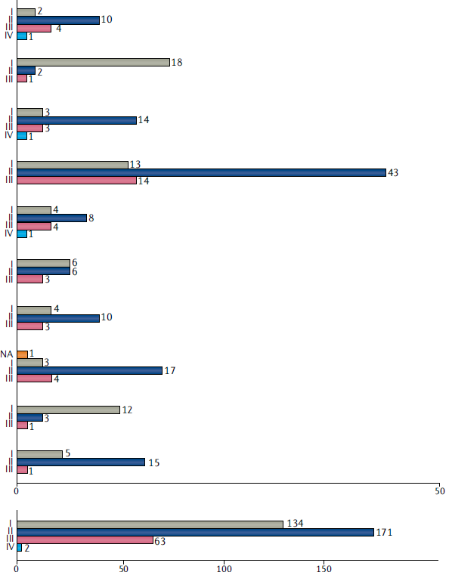

Cardiovascular disorders
Digestive system disorders
Eye disorders
Immune system disorders
Infectious diseases
Metabolic disorders
Nervous system disorders
Other disorders
Renal disorders
Respiratory tract diseases
Cancers
7
Sino Biological, Inc.
Number of agents per category and highest reached phase
Attwood MM et al. 2021

Slide 8
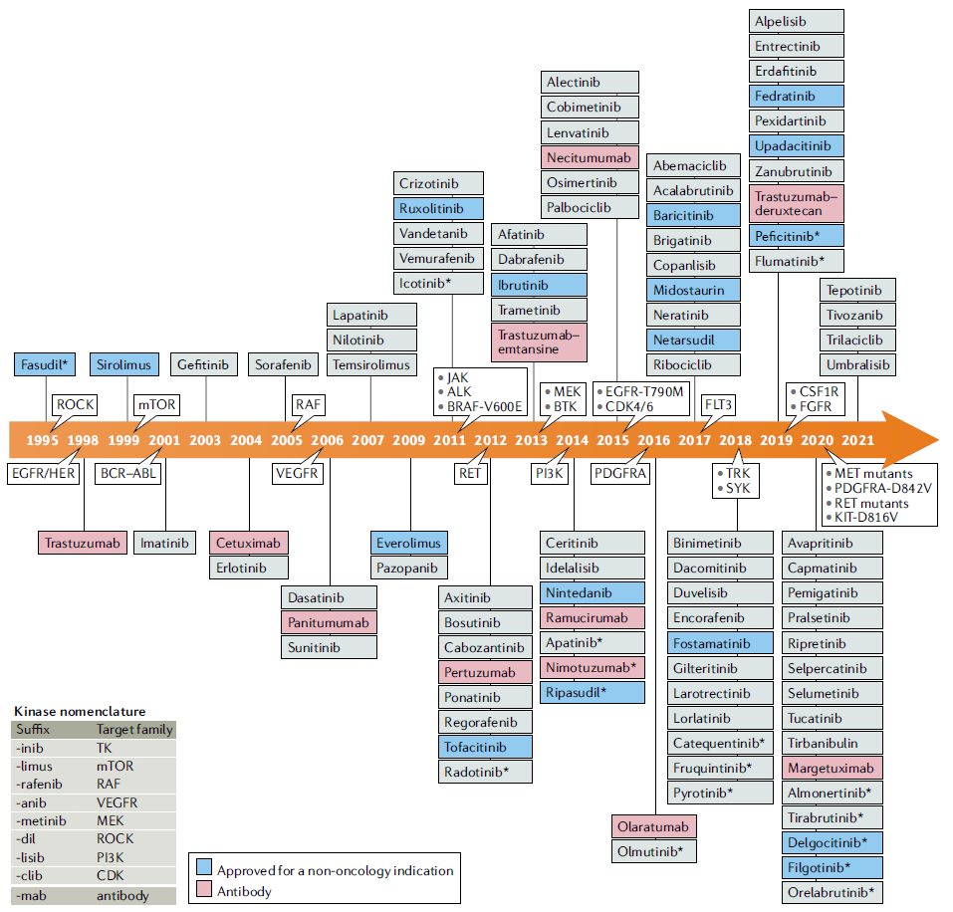
8
Sino Biological, Inc.
Attwood MM et al. 2021

Slide 9
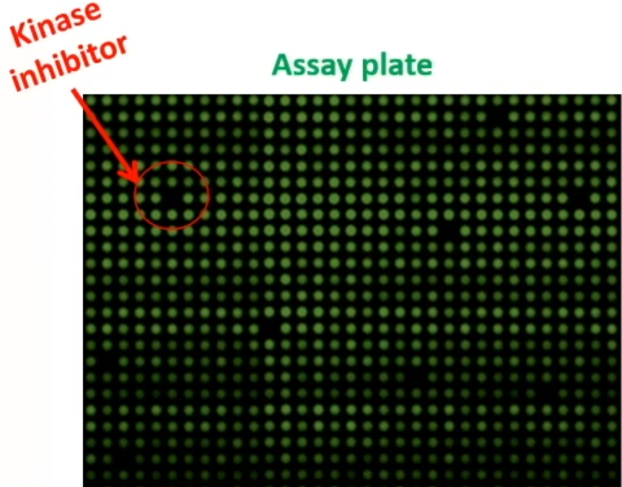
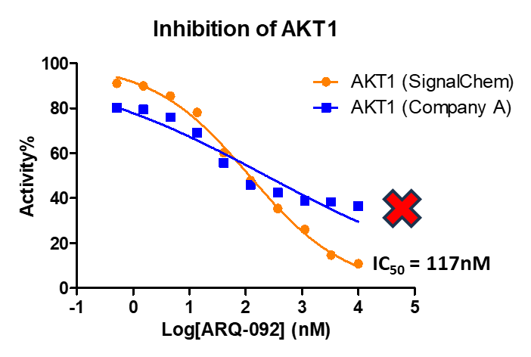
The need for active kinase
High activity
Low activity
Sino Biological, Inc.
9

Slide 10
03
Kinase assay technologies
Sino Biological, Inc.

Slide 11
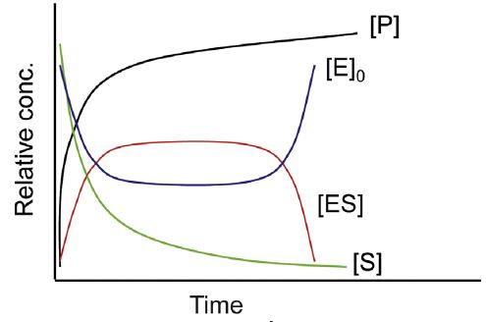
Kinase assay readouts
11
Sino Biological, Inc.

Slide 12
Biochemical kinase assay platforms
Phospho-peptide detection
Filter Binding
Lance® Ultra
ADP detection
ADP-Glo™
ATP detection
Kinase-Glo™
EasyLite™
AlphaScreen®
Transcreener®
Scintillation Proximity
Adapta™
LanthaScreen™
IMAP®-FP
PhosphoSens®
Mobility Shift
12
Sino Biological, Inc.

Slide 13
Detection of phospho-peptide
13
Sino Biological, Inc.

Slide 14
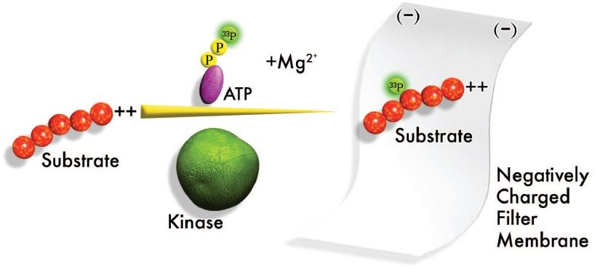
Filter binding assay
Pros | direct detection of substrate, extensively validated, sensitive
Cons | requires washing, low-throughput, radioactive waste, requires positively-charged substrate
14
Sino Biological, Inc.
Image: Upstate Group, Inc. 2004

Slide 15
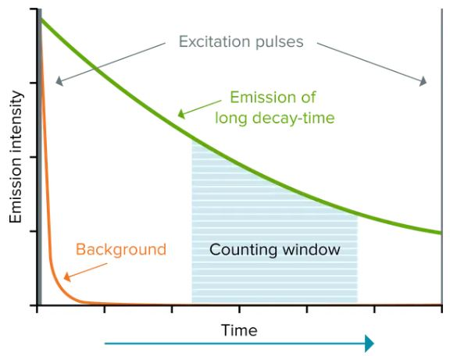
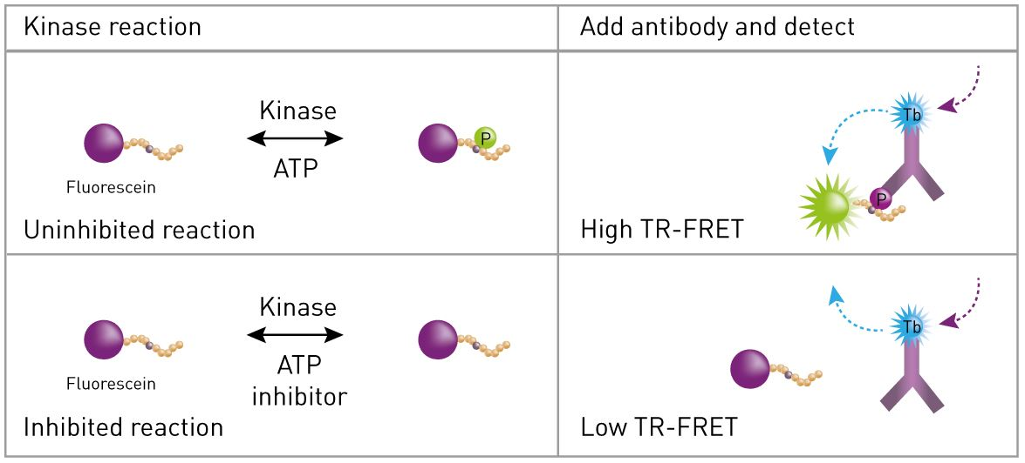
LanthaScreen assay
Pros | “mix-and-read”, HTS-compatible, highly sensitive
Cons | requires specific antibody, high cost of reagents
15
Sino Biological, Inc.
Image: https://www.bmglabtech.com
Notes:
镧系金属- 长寿命发射光—高信噪比

Slide 16
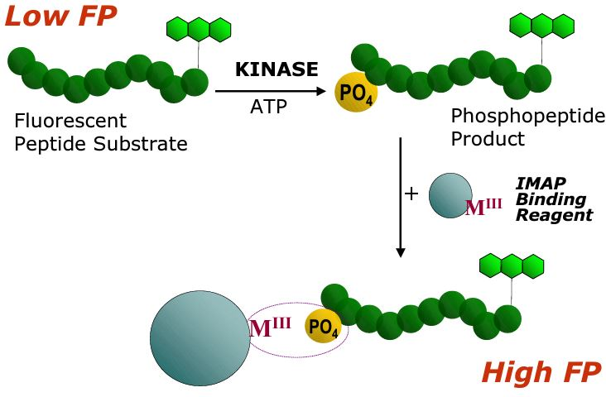
IMAP-FP assay
Pros | “mix-and-read”, simple workflow, multiplexable, HTS-compatible
Cons | susceptible to compound interference, substrate must be small peptide
16
Sino Biological, Inc.
Image: https://www.moleculardevices.com

Slide 17
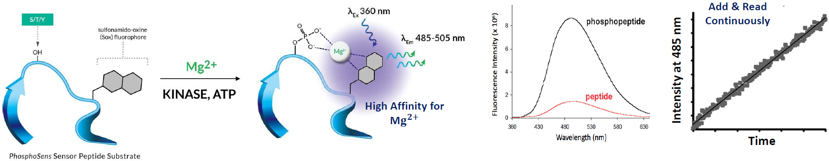
PhosphoSens assay
Pros | “mix-and-read”, continuous measurement, HTS-compatible
Cons | susceptible to compound interference, substrate must be small peptide
17
Sino Biological, Inc.
Cornell-Kennon S et al. 2024
Notes:
Peptide sequences are synthesized using solid-phase methods with the Sox fluorophore coupled through the sulfhydryl group of a cysteine residue proximal to a protein kinase phosphorylation site, such as a tyrosine, serine, or threonine. Upon addition of a kinase, the peptide is phosphorylated. In the presence of magnesium ion, a chelation complex is formed with the phosphate group, resulting in fluorescence enhancement of the Sox fluorophore monitored continuously as fluorescence intensity

Slide 18
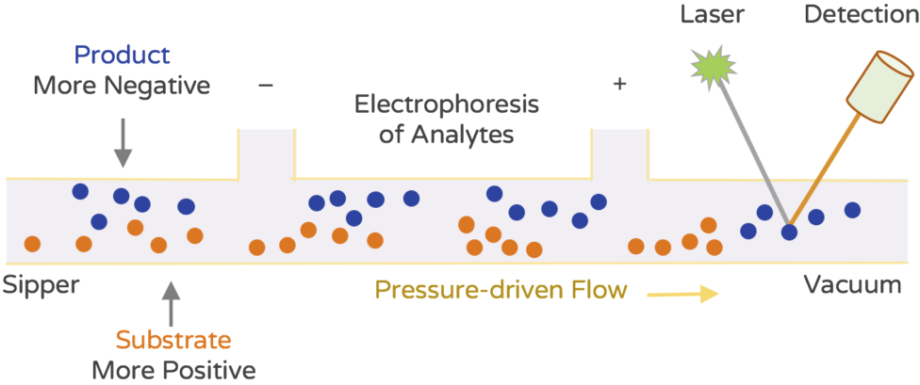
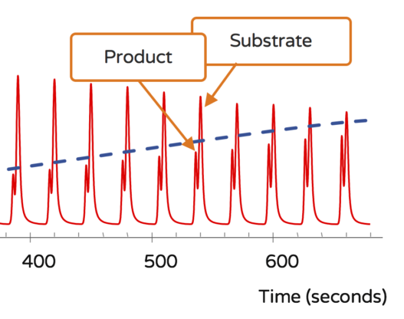
Mobility shift assay
Pros | low sample consumption, ease of automation, HTS-compatible
Cons | susceptible to compound interference, substrate must be short peptide with single phosphorylation site
18
Sino Biological, Inc.
Image: https://www.nanosyn.com/
Notes:
The target enzyme is incubated with fluorescently labeled substrate and test compounds in a standardized reaction mixture in 384 well plates. Upon termination of the reaction, samples are driven into capillaries or microfluidic channels where electric field is applied. The samples migrate across the electric field and product and substrate are separated based on the difference in their charge (electrophoretic mobility shift). Enzyme activity is measured by direct comparison of the fluorescence in the product and substrate peaks.

Slide 19
Detection of ADP
19
Sino Biological, Inc.

Slide 20
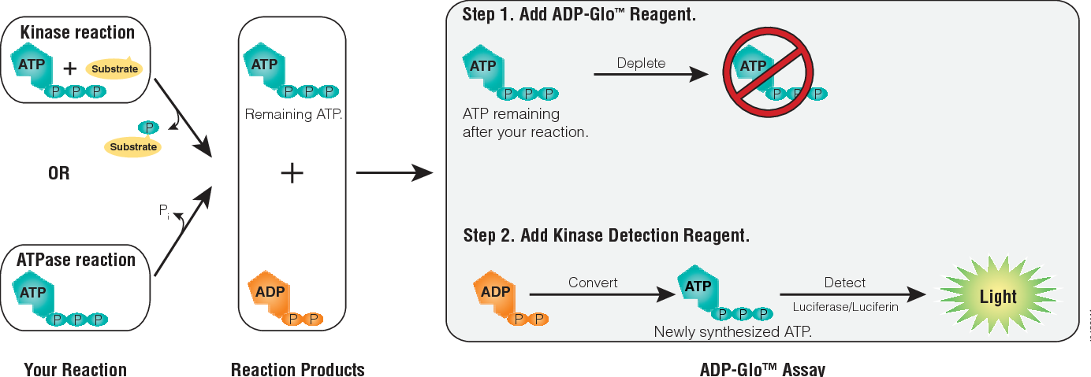
ADP-Glo assay
Pros | Highly sensitive, universal, high ATP tolerance, HTS-compatible, label-free
Cons | Coupling enzymes may produce false positives, interference from ATPase
20
Sino Biological, Inc.
Image: https://www.promega.com/

Slide 21
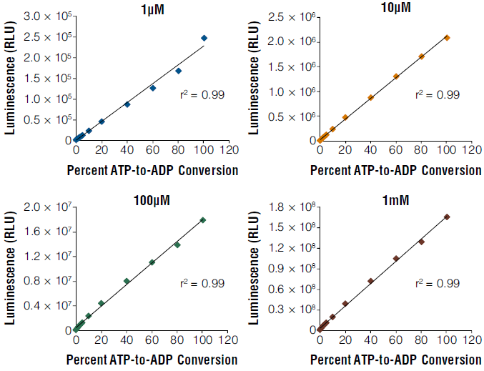
Sensitivity & linearity of ADP-Glo assay
21
Sino Biological, Inc.
Zegzouti H et al. 2009
Notes:
The assay is sensitive to low ATP conversion and the signal readout (RLU) is linear with ADP present at various ATP–ADP concentration ranges as shown. We found that using this assay we can detect as low as 0.1 pmol of ADP generated in the enzyme reaction.

Slide 22
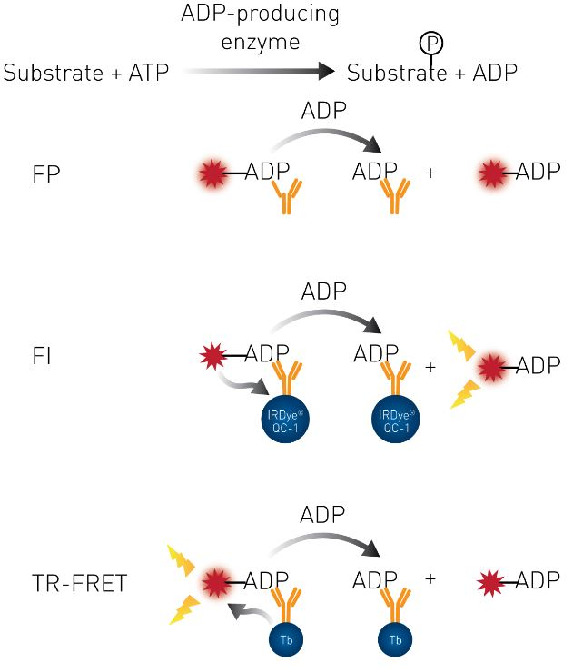
Transcreener/Adapta assay
Pros | Versatile, HTS-compatible, various detection modes
Cons | Antibody-dependent, specificity issues
Adapta
22
Sino Biological, Inc.
Image: https://bellbrooklabs.com

Slide 23
Detection of ATP
23
Sino Biological, Inc.

Slide 24
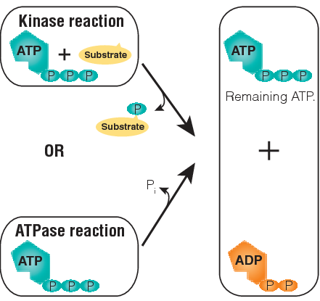
Kinase-Glo & EasyLite assay
Kinase-Glo
Light
Pros | Simple and short workflow, universal, HTS-compatible
Cons | Negative correlation - small assay window, narrow linear range (EasyLite, 10nM-10uM ATP)
24
Sino Biological, Inc.
Image: https://www.promega.com/

Slide 25
Summary of common kinase assays
Analyte | Assay name | Assay technology | Assay principle | Pros | Cons
Phospho-peptide | Filter Binding Assay | Radioactivity | 33P-labeled phospho-peptide is captured on nitrocellulose paper | Direct detection of phospho-peptide, sensitive | Radioactive waste disposal; low throughput
 | Scintillation Proximity Assay |  | 33P-labeled peptide-biotin is captured on a detection bead which scintillates from proximity to the radioisotope | Homogeneous, sensitive | Radioactive waste disposal; cost of SPA beads
 | LanthaScreen | TR-FRET | Europium or Terbium-chelated donor linked with anti-phospho antibody. Fluorophore-labelled peptide as acceptor | Sensitive, high throughput | Antibody-dependent, high cost of reagents
 | Lance Ultra
 | AlphaScreen | Luminescence | Phospho-peptide brings donor and acceptor beads to proximity through coated conjugates. Upon excitation, donor bead excites oxygen which reacts with acceptor bead generating signal | Highly sensitive, can use protein or peptide substrate | Cost of reagents; antibody-dependent, or susceptible to phosphate interference
 | IMAP-FP | Fluorescence polarization (FP) | Fluorophore-labeled phospho-peptide binds to metal coated beads and generates high FP signal | Simple workflow, multiplexable | Compound interference; substrate must be short peptide
 | PhosphoSens | Fluorescence (FI) | Phospho-peptide brings Mg²⁺ to the proximity of labeled fluorophore (SOX) which generates enhanced fluorescence when bound to the Mg²⁺ | Continuous assay, high ATP tolerance, high throughput | Compound interference; substrate must be short peptide
 | Mobility Shift Assay |  | Time-gated fluorescence detection of substrate and product due to their different electrophoretic mobilities | low sample consumption, ease of automation | Compound interference; substrate must be short peptide with single phospho-site
ADP | ADP-Glo Assay | Luminescence | Quantification of kinase dependent ADP production by converting it to ATP and ATP is measured in a luciferase reaction | Highly sensitive, universal, label-free, high ATP tolerance | Coupling enzymes may produce false positives; ATPase interference
 | Transcreener | FP/Fl/TR-FRET | ADP from the kinase reaction replaces with fluorophore-labeled ADP bound to anti-ADP antibody | Versatile, multiple detection modes | Antibody-dependent, high cost of reagents; non-specific recognition
 | Adapta | TR-FRET | Europium-chelated donor linked with anti-ADP antibody. Fluorophore-labelled ADP as acceptor | Sensitive, high throughput
ATP | Kinase-Glo Assay | Luminescence | ATP-dependent luminescent signal from luciferase conversion of luciferin. Kinase dependent depletion of ATP is quantified | Simple workflow, inexpensive, universal | Signal inverse correlation - small assay window
 | EasyLite
Notes:
Except for the FB assay, all other can be adapted for HTS.
Which platform to choose for your application, is going to dependent on many factors, including target characteristics, instrument, sourcing of reagents, budget, screening scale, and data format/quality.

Slide 26
04
SignalChem assay platforms and kinase assay case studies
Sino Biological, Inc.

Slide 27
SignalChem active enzyme products
Category | Product Group | # of Products
Active enzymes | Kinases | 1163
 | Phosphatases | 40
 | Epigenetic Enzymes | 132
 | Ubiquitin Enzymes | 98
 | Arginine Deiminases | 7
 | G Proteins | 52
 | Proteases | 3
 | Phosphodiesterases | 23
 | Other Enzymes – Oxidoreductases, Transferases, Hydrolases | 19
Total Products |  | 1537
27
Sino Biological, Inc.
Notes:
Here is a brief snapshot of SignalChem’s active enzymes. We list them in nine product groups and I have highlighted the kinase group, which is our largest product portfolio.

Slide 28
Assay technology | Assay name | Analyte | Protein family
Luminescence | ADP-Glo | ADP | Kinase
 | AMP-Glo | AMP | Ubiquitinating enzyme (E1, E2, E3)
 | MTase-Glo | S-Adenosyl Homocysteine (SAH) | Methyltransferase
 | GTPase-Glo | GTP | GTPase
 | HDAC-Glo | Luciferin | Histone deacetylase
 | PDE-Glo | cAMP, cGMP | Phosphodiesterase
 | ROS-Glo | H₂O₂ | Histone demethylase
 | Succinate-Glo | Succinate
 | DUB Lit | Luciferin | Deubiquitinase
UV-Vis absorbance | BIOMOL Green | Phosphate | Phosphatase
 | pNA colorimetric assay | p-Nitroanilide | Protease
Fluorescence/TR-FRET | Cleavage assay, LanthaScreen | Fluorescent- or phospho-peptide | Protease, kinase
Immunoassay | ELISA | Acetylated or citrullinated peptide | Bromodomain, acetyltransferase, arginine deiminase
 | PROTAC assay | Ubiquitinated protein | Ubiquitin E3 ligase
Notes:
Current biochemical assay platforms for both product validation as well as custom profiling service. All these assays can be grouped into 4 categories based on the detection technology. The largest group is luminescence-based assays for which we have been taking advantage of Promega’s enhanced luciferase. We have adapted these Glo reagents to our own needs and developed assays specific for each these major product family. The reason we chose the Glo system is not only because the assays are highly sensitive, homogeneous and HTS-compatible, but also because we have a long-time successful partnership with Promega.

Slide 29
Compound screening
Identify through compound library screenings, candidates that affect the target in the desired way, so-called “hits”, or “leads”
Developing compound screening assays requires:
  Identification of relevant enzyme and substrate forms
  Measurements of kinetic parameters
  Characterization of co-factors and buffers
  Choice of detection technology
  Mode of action (MOA) study
29
Sino Biological, Inc.

Slide 30
Mode of action
Enzyme kinetics
Streamlined inhibitor profiling
ADP-Glo kinase assay - case studies
30
Sino Biological, Inc.

Slide 31
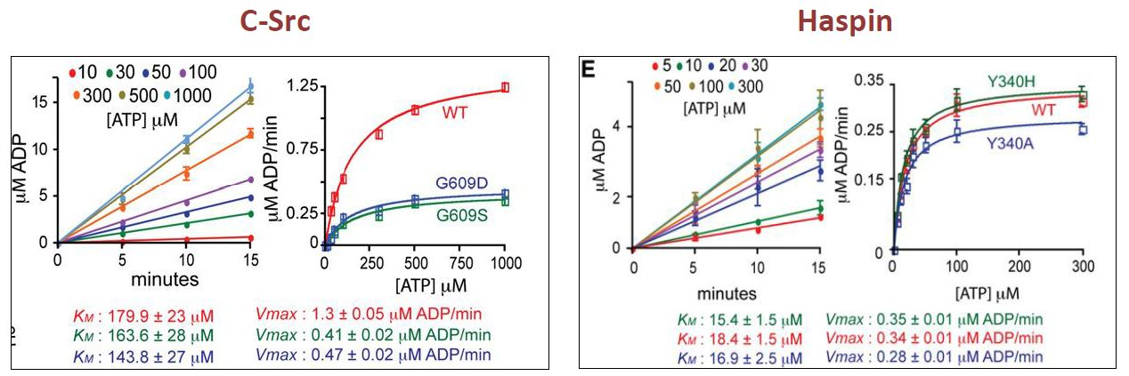
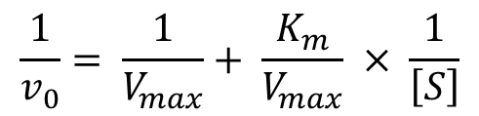
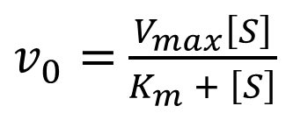
Determination of kinetic parameters
$v_{0}=$ $\frac{V_{max}\left[S\right]}{K_{m} + \left[S\right]}$
$$\frac{1}{v_{0}}= \frac{1}{V_{max}}+ \frac{K_{m}}{V_{max}} × \frac{1}{\left[S\right]}$$
31
Sino Biological, Inc.
Zegzouti H et al. 2013

Slide 32
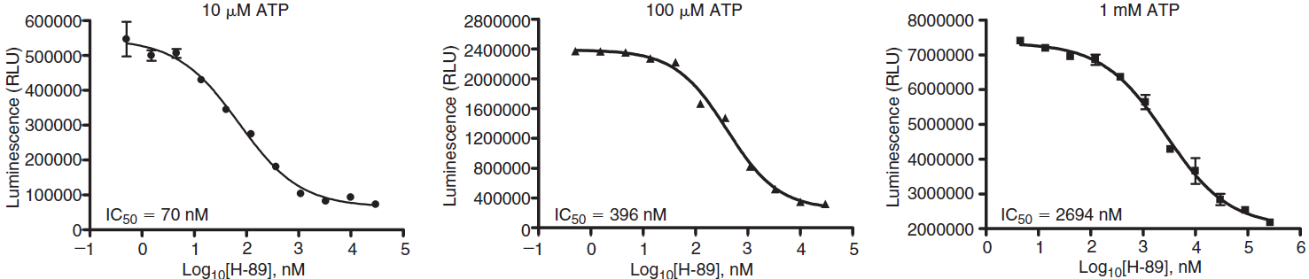
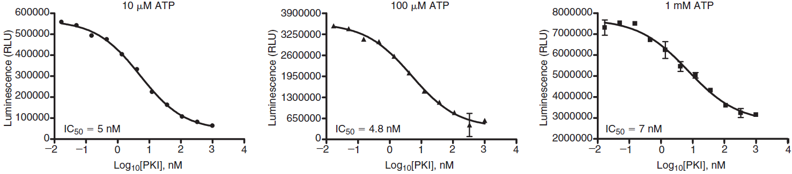
ATP competitive vs non-competitive inhibition
PKA ATP competitive inhibitor H-89
70nM
396nM
2694nM
PKA ATP non-competitive inhibitor PKI
5nM
4.8nM
7nM
32
Sino Biological, Inc.
Zegzouti H et al. 2010

Slide 33
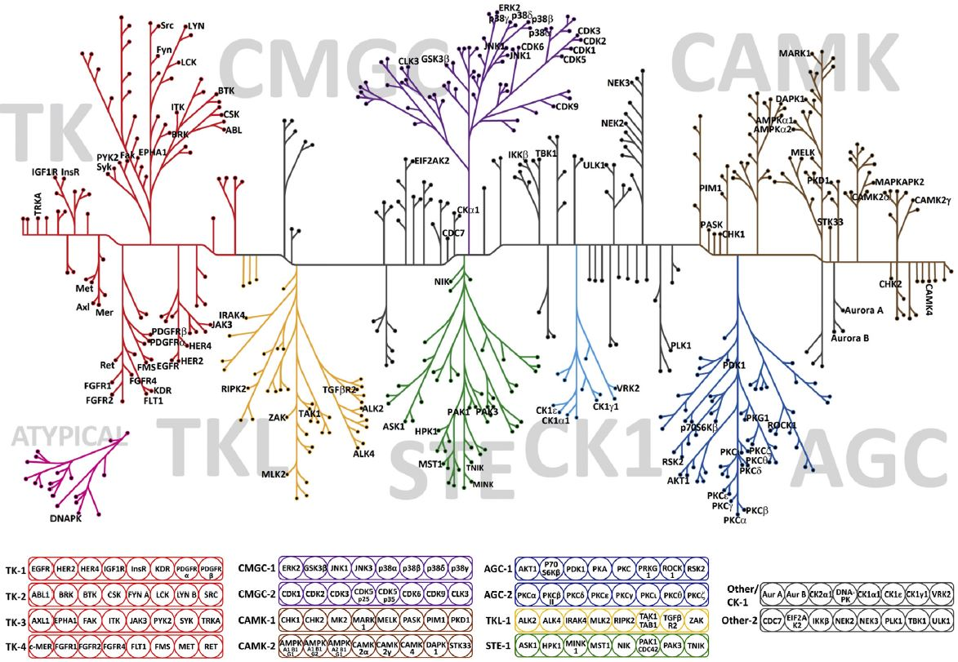
Kinase Selectivity Profiling Systems (KSPS)
33
Sino Biological, Inc.
Hennek J et al. 2016

Slide 34
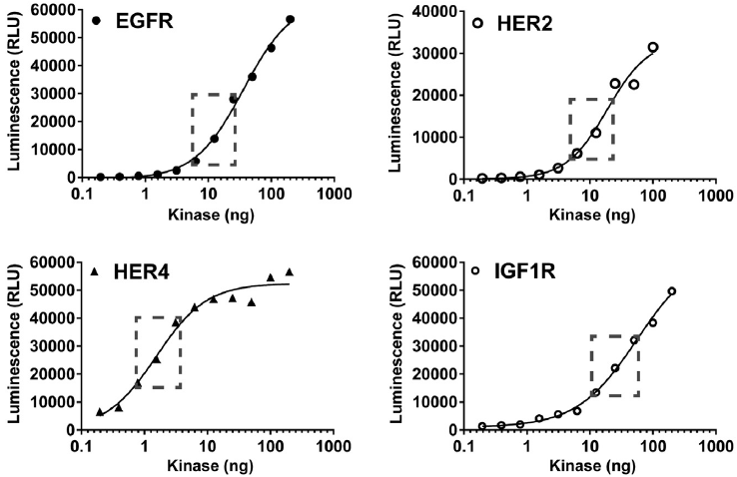
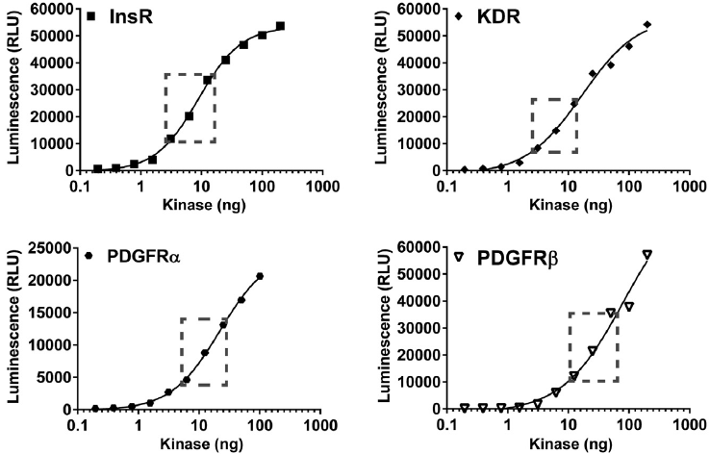
KSPS: standardized kinase activities
34
Sino Biological, Inc.
Notes:
The dashed insets represent the linear area of each kinase curve where the amount selected for each enzyme produces approximately 10-30% ATP to ADP conversion with at least a signal-to-background ratio of 10 at 10 mM ATP.

Slide 35
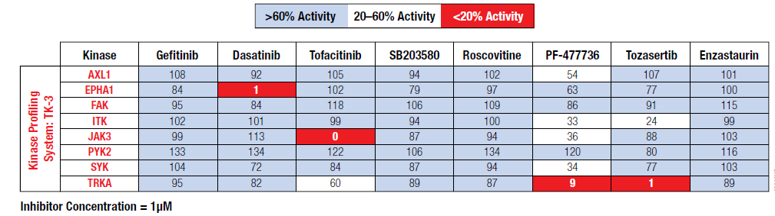
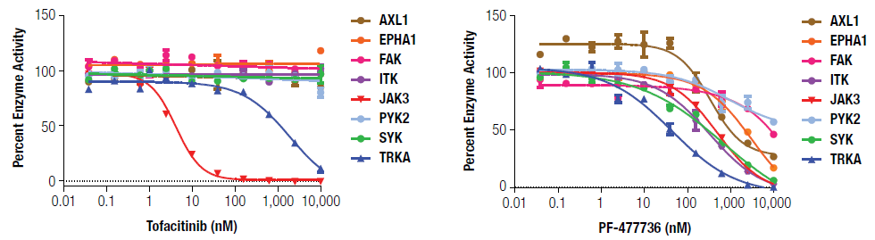
KSPS: single-dose & dose-response profiles
35
Sino Biological, Inc.
Notes:
Each of these Profiling Systems provides enough material to profile up to 20 compounds at a single dose or create a dose response for two compounds against eight kinases at once.
These are also the two common formats of how we provide compound profiling services to our customers.

Slide 36
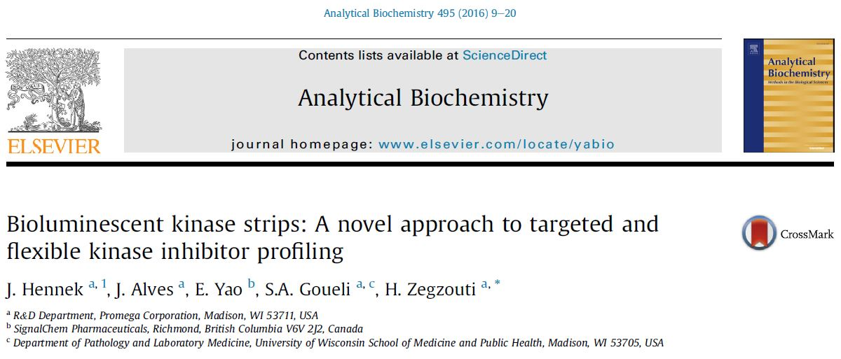
36
Sino Biological, Inc.

Slide 37
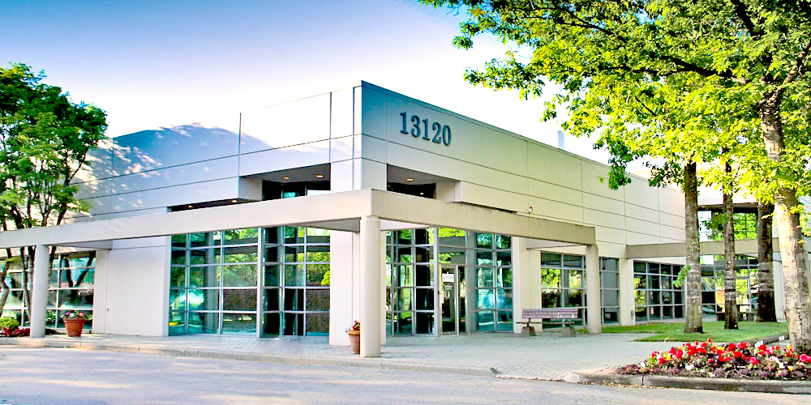


SignalChem Biotech (Part of Sino Biological)
The World Leader in Kinases
20+ Years of Expertise in Enzyme and Assay Development
Founded in 2004
Located in Richmond, BC, Canada
Acquired by Sino Biological in 2024
Enzymes, Proteins, Compounds, Substrates, Assay Reagents, and Custom Services
1100+ Active Kinases
1500+ Active Enzymes
Custom Services
• Covering over 90% of human kinome
700+ wild-type kinases
• 400+ clinically relevant mutant kinases
World’s largest active kinase catalog
Phosphatases, epigenetic enzymes, ubiquitin enzymes, and more
Custom enzyme development
Compound screening and profiling
Assay development

Slide 38


The World Leader in Kinases
Contact Us:
Sino Biological, Inc.
Address: Building 9, Jing Dongbei Technology Park, No.18 Kechuang 10th St, BDA, Beijing, 100176, P.R.China
Tel: 400-890-9989
Email: order@sinobiological.com
Website: cn.sinobiological.com
Thank you!
Questions?
Follow us on WeChat!
Sino Biological, Inc.

