Slide 1
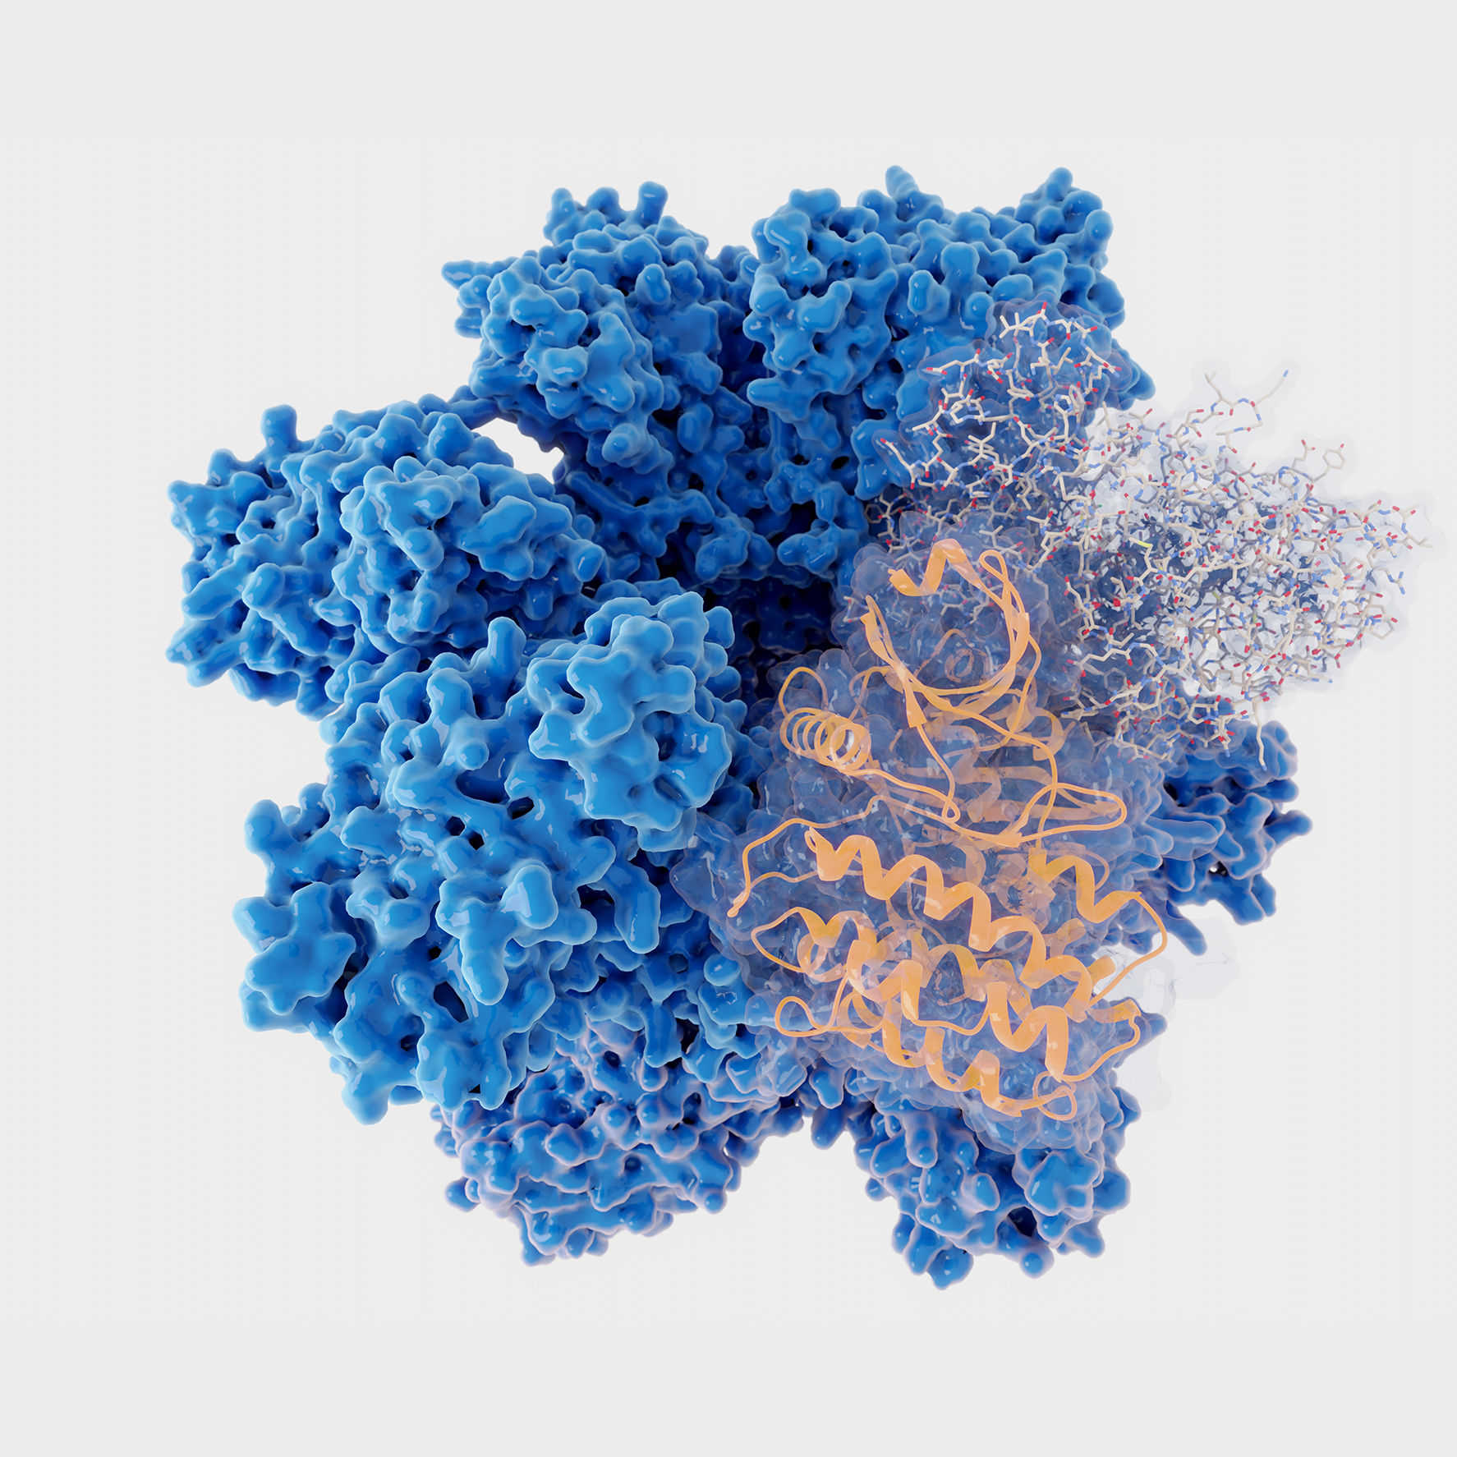



Recombinant kinase production, quality control and applications
Yuxiang Hu, MD
Chief Scientific Officer
Sino Biological/SignalChem Biotech
October 2024

Slide 2
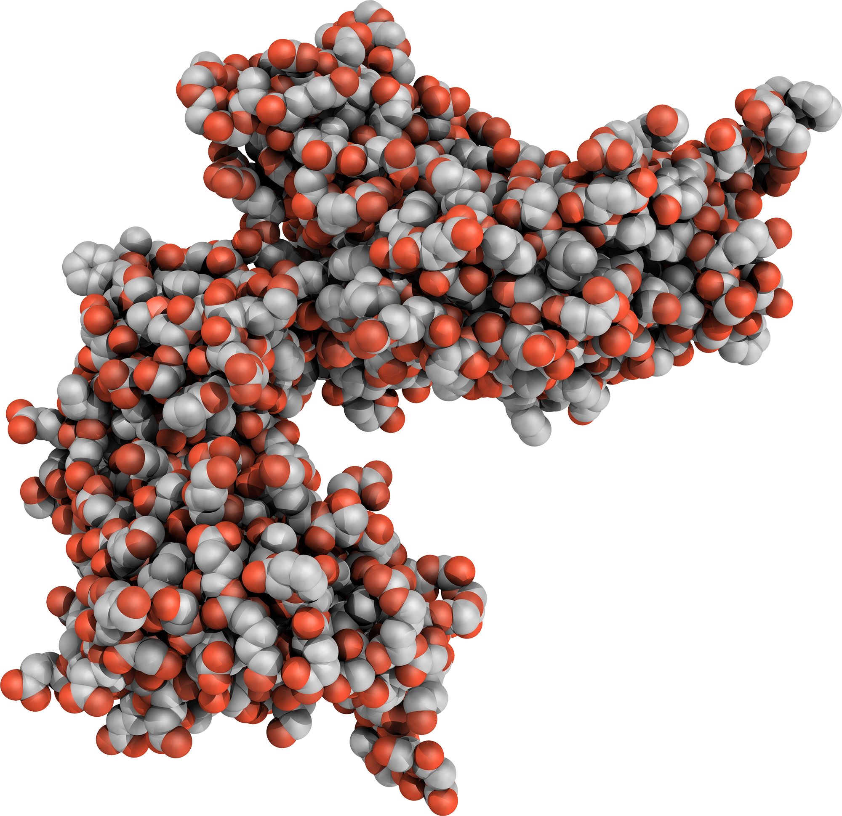


CONTENT
1
Background information of kinases
2
Manufacturing process of recombinant kinases
3
Quality control
4
Recombinant kinase applications
Sino Biological, Inc.

Slide 3
01
Background information of kinases
Sino Biological, Inc.

Slide 4
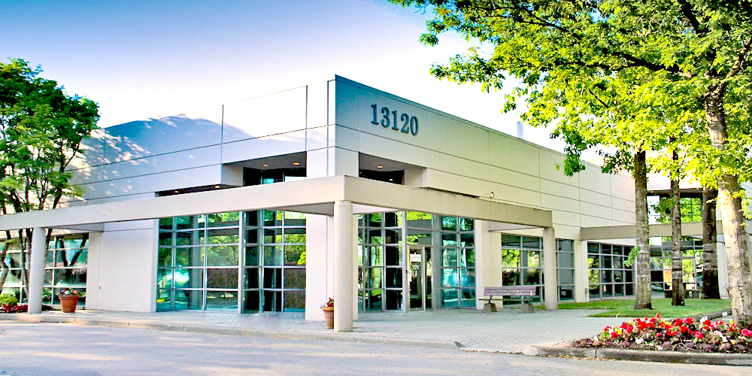


SignalChem Biotech (Part of Sino Biological)
Founded in 2004
Located in Richmond, BC, Canada
Acquired by Sino Biological in 2024
The World Leader in Kinases
20+ Years of Expertise in Enzyme and Assay Development
Enzymes, Proteins, Compounds, Substrates, Assay Reagents, and Custom Services
Sino Biological, Inc.

Slide 5
SignalChem active enzyme products
Category | Product Group | # of Products
Active Enzymes | Kinases | 1163
 | Phosphatases | 40
 | Epigenetic Enzymes | 132
 | Ubiquitin Enzymes | 98
 | Arginine Deiminases | 7
 | G Proteins | 52
 | Proteases | 3
 | Phosphodiesterases | 23
 | Other Enzymes – Oxidoreductases, Transferases, Hydrolases | 19
Total Products |  | 1537
Sino Biological, Inc.
Notes:
Here is a brief snapshot of SignalChem’s active enzymes. We list them in nine product groups and I have highlighted the kinase group, which is our largest product portfolio.

Slide 6
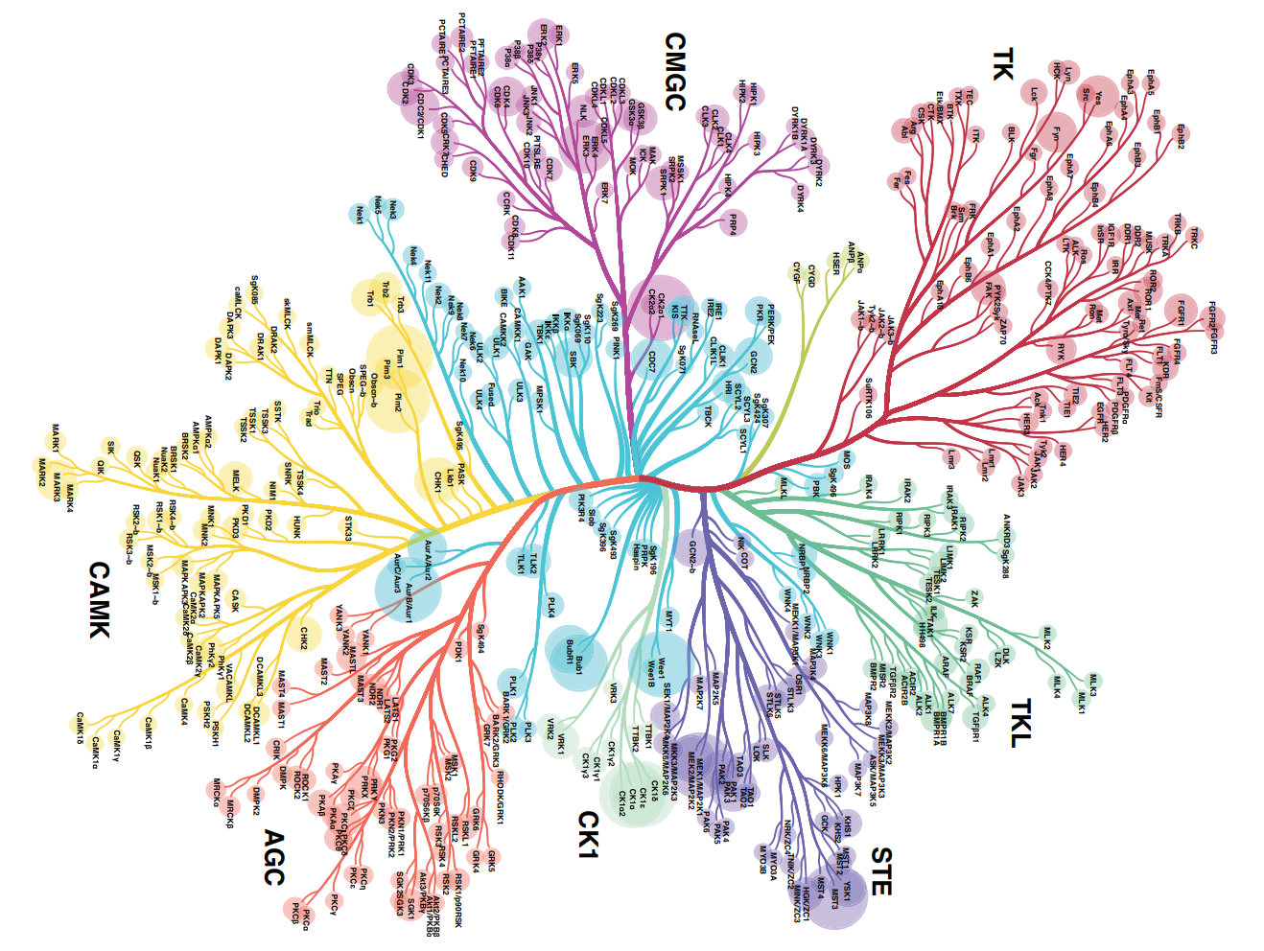
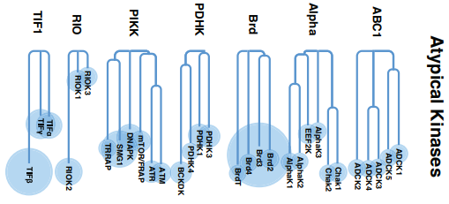
Kinase kinome
90% kinome coverage
700 wild-type variants
400 disease-relevant mutant kinases
Sino Biological, Inc.
Notes:
Cell Signaling technology phosphositePlus (www.phosphosite.org) and the Kinexus PhosphoNET (www.phosphonet.ca) website both list over 200,000 phosphosites
Ardito F etal. Int J Mol Med (2017) 40:271-280

Slide 7
ATP
ADP
Kinase
P
Substrate
Product
Proteins
Lipids
Carbohydrates
Serine/Threonine protein kinases
Tyrosine kinases
Dual specificity protein kinases
Kinases that phosphorylate serine and/or threonine residues on substrates
Kinases that phosphorylate tyrosine residues on substrates
Kinases that phosphorylate both serine/threonine and tyrosine residues
PKA, AKT, CDKs, MAPKs …
EGFR, FGFR, SRC, ABL1 …
MEK1, DYRK3 …
Sino Biological, Inc.

Slide 8
Main functions of kinases
Functions | Description | Examples of Kinases
Signal Transduction | Mediates cellular responses to external signals | Tyrosine Kinases (e.g., EGFR)
Cell Cycle Regulation | Controls progression through the cell cycle | Cyclin-dependent Kinases (CDKs)
Metabolism Regulation | Influences metabolic pathways and energy production | AMPK
Gene Expression Modulation | Alters transcription factors to influence gene expression | Various Serine/Threonine Kinases
Cell Growth and Differentiation | Affects processes related to cell growth and development | MAPKs, Tyrosine Kinases
ATP
Cheng HC et al. (2011). Enzyme Res, 2011:794089
Ardito F et al. (2017). Int J Mol Med, 40:271-280
Sino Biological, Inc.
Notes:
The human genome comprises about 500 protein kinase genes and accounts for around 2% all human gene. Kinase activity can alter up to 30% of all human proteins.

Slide 9
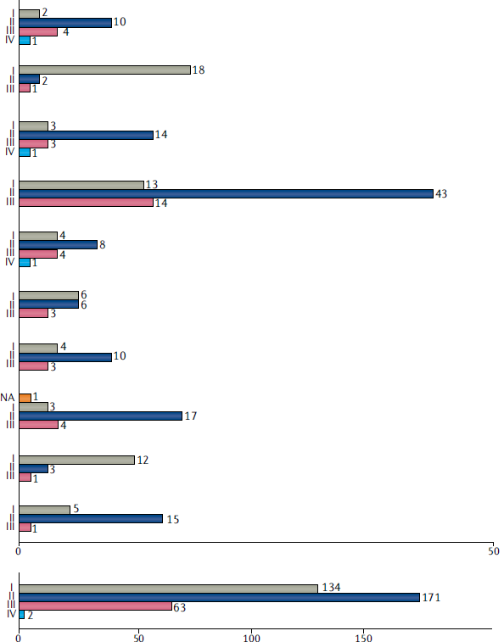

Abnormal kinase functions are associated with various diseases
Cardiovascular disorders
Digestive system disorders
Eye disorders
Immune system disorders
Infectious diseases
Metabolic disorders
Nervous system disorders
Other disorders
Renal disorders
Respiratory tract diseases
Cancers
Sino Biological, Inc.
Number of agents per category and highest reached phase
Attwood MM et al. (2021). Nat Rev Drug Discov, 20:289

Slide 10
02
Manufacturing process of recombinant kinases
Sino Biological, Inc.

Slide 11

Manufacturing process of recombinant kinases
Primer Design
Cloning
Sequencing
Bacterial/Yeast/Insect/
Mammalian Cell Culture
SDS-PAGE, Activity Assays
Gene Synthesis & Subcloning
Plasmid/
Virus
Expression Evaluation & Optimization
Protein Purification
QC/QA
Package & Delivery
Protein
ATP
Expression Vectors
Affinity Chromatography, Ion Exchange, Gel Filtration
Storage
Shipping
Sino Biological, Inc.

Slide 12
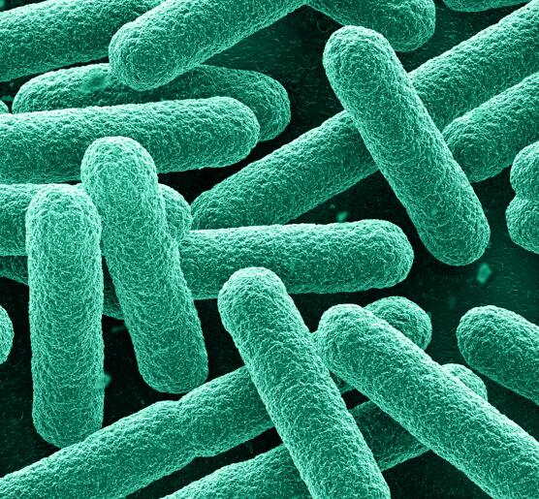
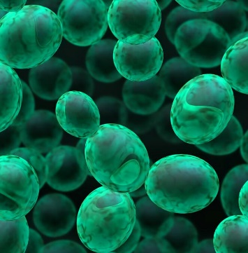
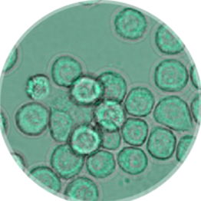
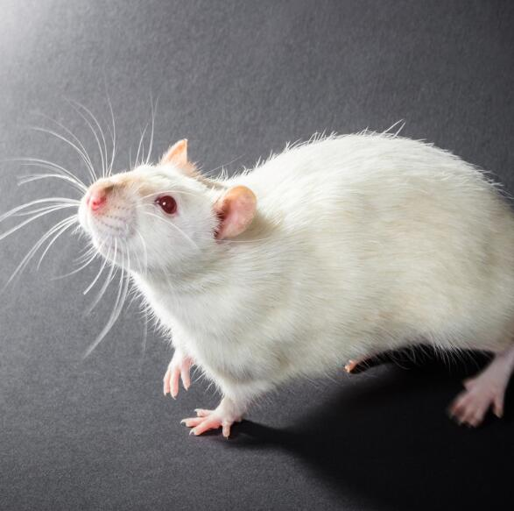
We prefer insect cells for kinase expression
Bacteria
Yeast
Insect
Mammalian
ATP
E. coli
S. Cerevisieae
P. Pastoris
Sf9, Sf21, High 5
CHO, HEK
1. “Work Horse”
2. Well Established
3. High Expression
4. Simple Genetics
5. Easy Scale up
7. Low Cost
1. PTMs
2. Soluble Proteins
3. High Expression
4. Easy Scale up
1. PTMs
2. Soluble Proteins
3. High Expression
1. PTMs
2. Soluble Proteins
3. Lower expression
4. Expensive
Sino Biological, Inc.

Slide 13
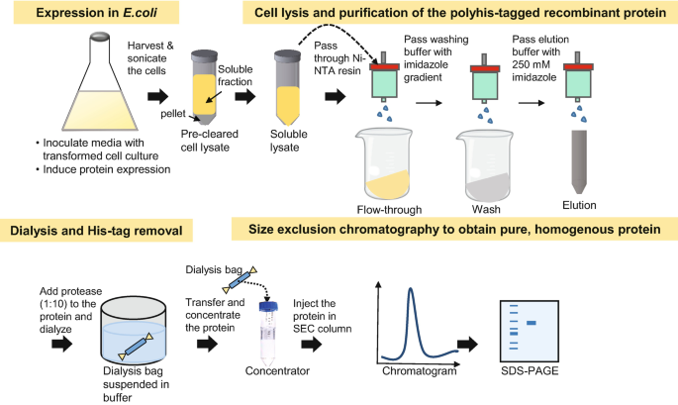
Protein purification
Harvest Extraction
Centrifuga-tion
Chromatographic Methods
Detection & Analysis
ATP
The whole process is kept on ice or 4 °C to retain activity!
Sino Biological, Inc.

Slide 14
03
Quality control
Sino Biological, Inc.

Slide 15
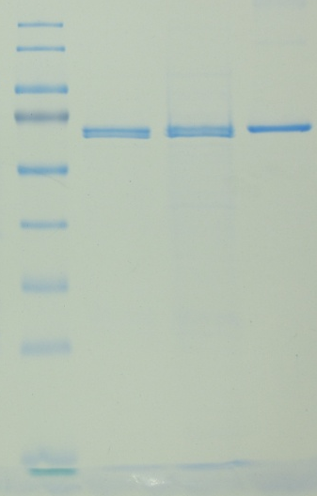
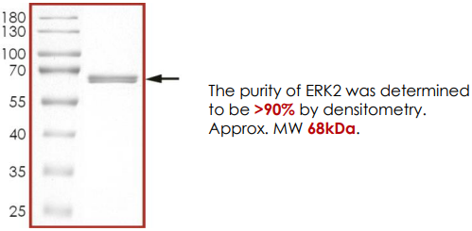
Quality controls
SDS-PAGE gel running
Size
Concentration
Purity
Activity test
ADP-Glo
Other assays
Existing batch
New batch
ERK2
BSA
(Internal)
(Datasheet)
Sino Biological, Inc.

Slide 16
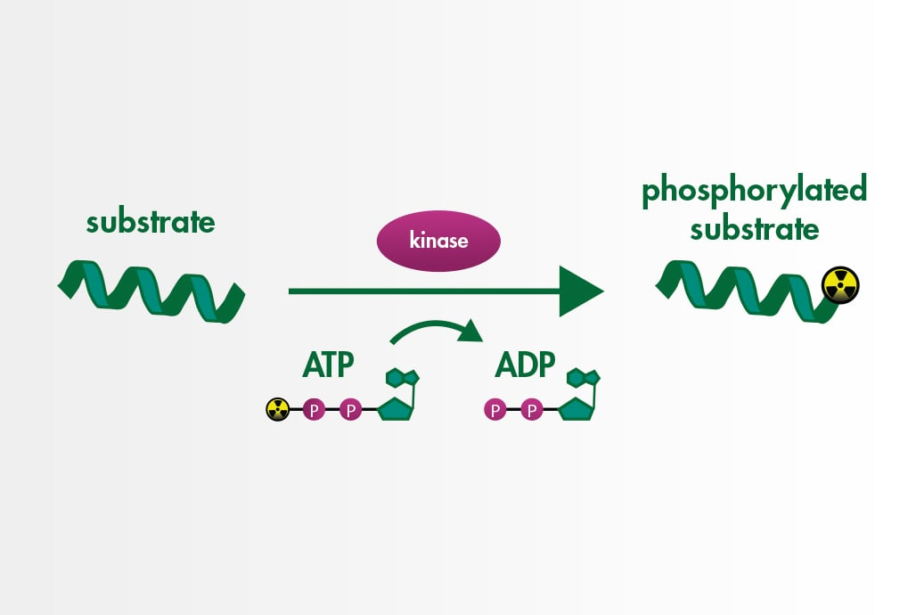
Filter binding radiometric kinase assay
Direct detection of radioactive labeled substrate, high specificity, high sensitivity.
Requires washing step, radioactive waste, also needs a positively charged substrate.
Reaction Biology website
Sino Biological, Inc.

Slide 17
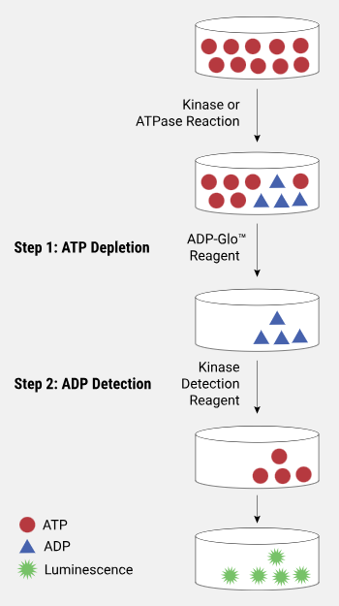
ADP-Glo kinase assay
ADP-Glo kinase assay protocol
A homogeneous luminescent assay to detect ADP (range of ~1 mM – 0.01 µM) (no washing step)
High sensitivity: Detect 0.2 pmol ADP with more than 2-fold diﬀerence over the background
Any ADP-generating enzyme (e.g., kinase or ATPase) using up to 1 mM ATP
Also detect kinase which has auto phosphalization effect
Sino Biological, Inc.
Promega website

Slide 18
Validation of activity and lot-to-lot consistency
ATP
Sino Biological, Inc.

Slide 19
04
Recombinant kinase applications
Sino Biological, Inc.

Slide 20
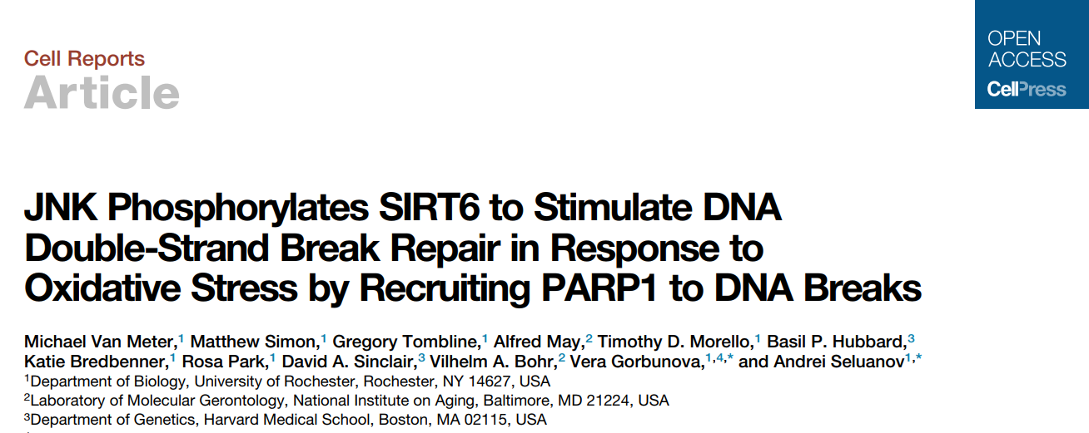
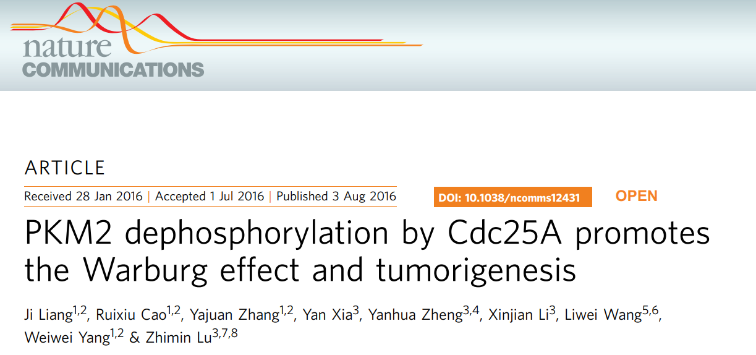
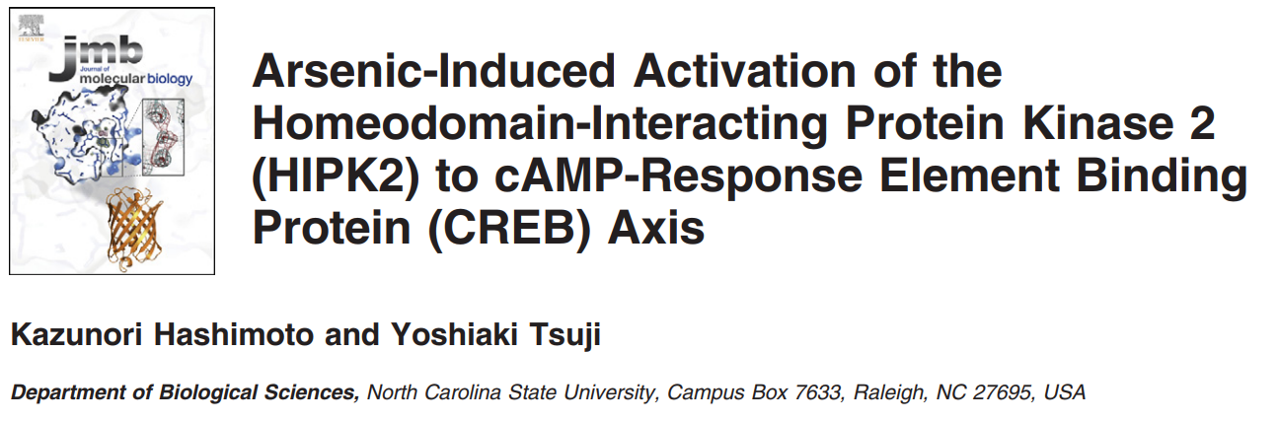
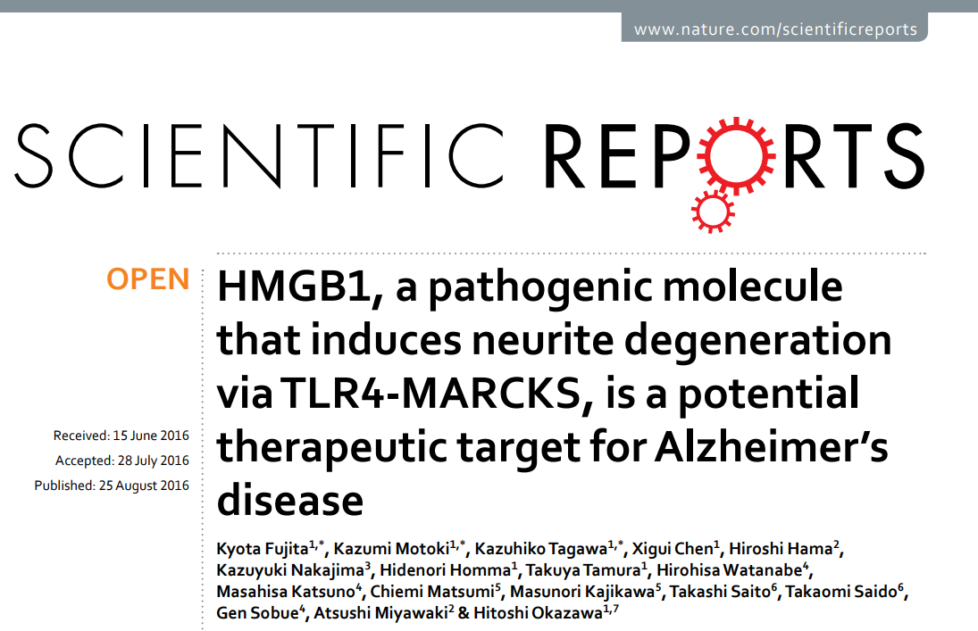
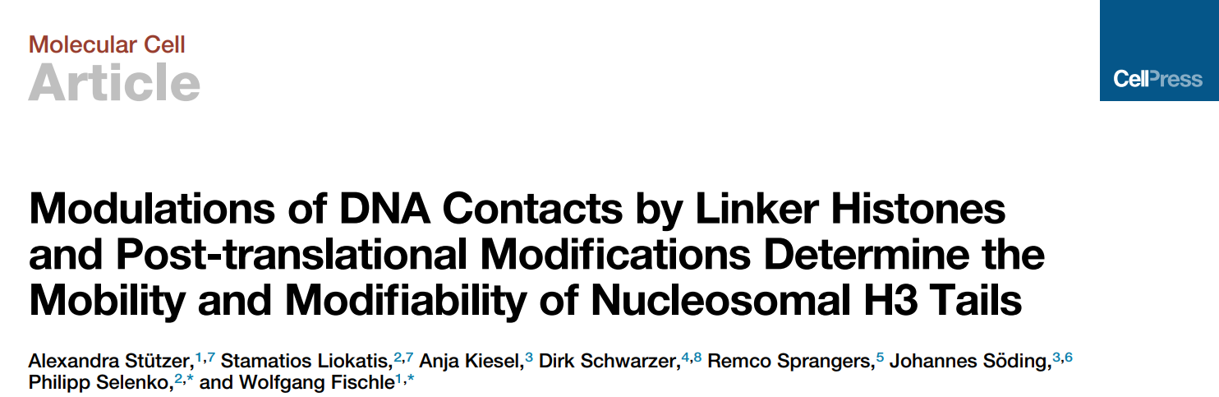
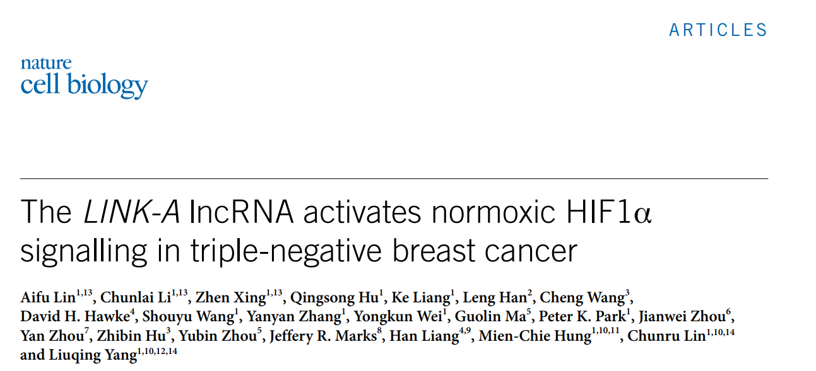
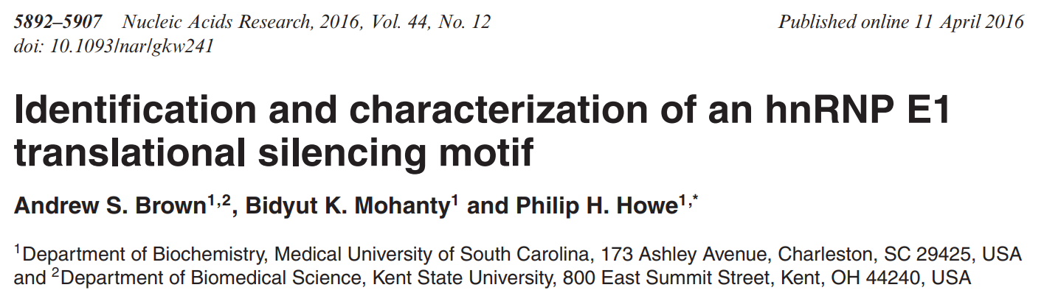
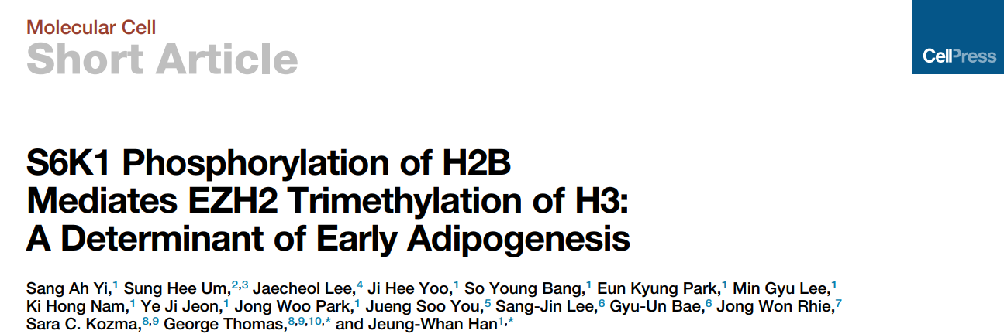
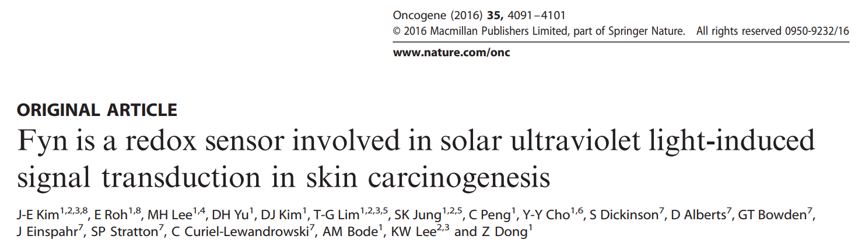
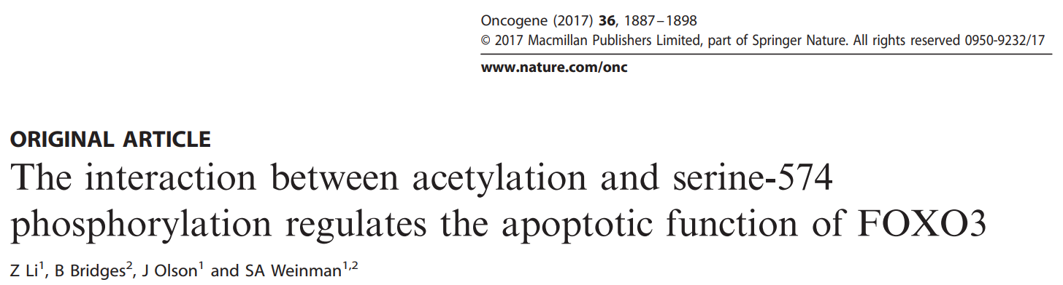
>1800 PUBLICATIONS IN HIGH IMPACT JOURNALS
ATP
Sino Biological, Inc.

Slide 21
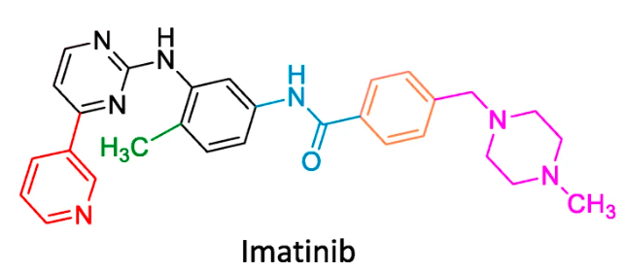
The first small molecule kinase inhibitor
approved by FDA (2001)
Gleevec (imatinib) is the first kinase inhibitor approved by the FDA.
Targeting BCR-ABL fusion kinase from the initial study. It is also reported to target PI3K, BRAF, EGFR and mTOR.
Used for treating chronic myelogenous leukemia (CML), and later for several types of other cancers such as ALL and gastrointestinal tumors (GIST), melanoma, lung cancer and renal tumors.
“The beginning of a new era of precision medicine”
Pray, L (2008). Nature Education, 1(1):37
Ardito F et al (2017). Int J Mol Med 40: 271
Sino Biological, Inc.
Notes:
Vast majority of CML cases and 20-30% of those of ALL (acute lymphoblast leukemia) are caused by a reciprocal chromosome translocation between chromosome 9 and 22 t(9, 22), so called philadelphia chromosome. The product of this generic rearrangement in BCR-ABL fusion protein with deregulated tyrosine kinase activity leads to immune precursors divide endlessly.
It is also called a miracle drug or a silver bullet.
also targeting CSF1R, c-KIT, FLT3, and PDGFFR-beta.

Slide 22
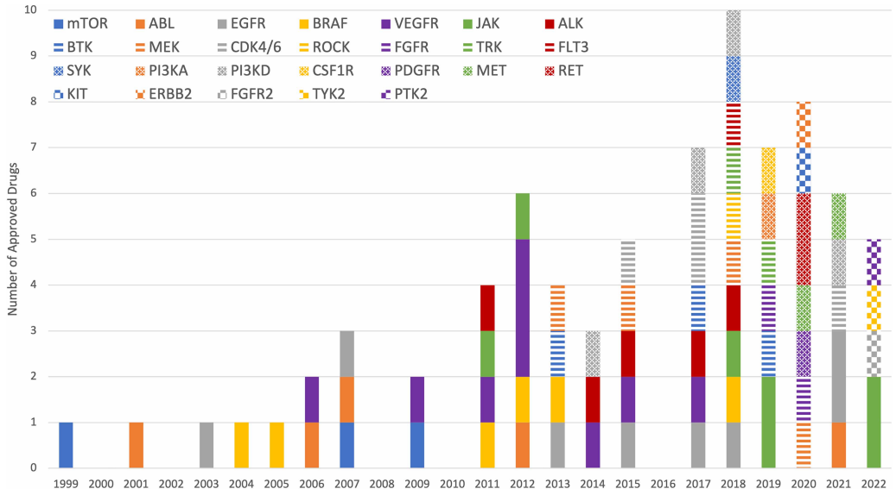
FDA approved drugs and main targeted kinases
Since Imatinib’s approval, over 80 kinase inhibitors have been approved as of September 2024.
In the last 6 years, at least 5 kinase inhibitors were approved by the FDA each year.
The data provides a clear demonstration of the druggability of the kinase protein class.
https://brimr.org/protein-kinase-inhibitors/
Brian A et al. (2023). Biochemical Journal 480:1331
Sino Biological, Inc.

Slide 23
Development of in-house AXL inhibitor: SLC-391
  Identified by high-throughput screening based on the platform using in-house kinases
  Specifically and potently inhibits AXL
  Signaling in vitro and in vivo
  Desirable pharmacokinetic properties
  Anti-cancer properties in mice
  Currently at clinical trial phase II
Sino Biological, Inc.

Slide 24
Acquired kinase mutation
The major challenge using small molecule kinase inhibitors is the emergence of drug resistance.
Acquired mutations within the kinase domain are a common drug resistance mechanism.
Biswas et al. (2024). Chem.Sci. 15:13130
Sino Biological, Inc.

Slide 25
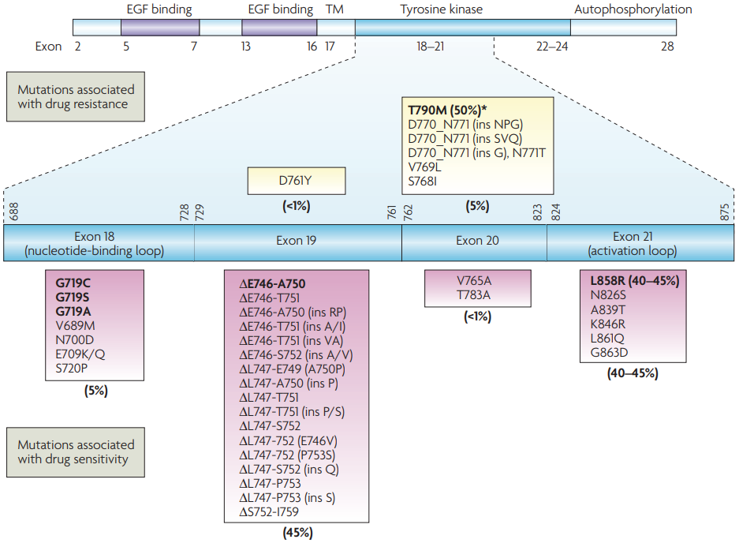
Various EGFR mutants and acquired EGFR mutations
Sino Biological, Inc.
Sharma et al. (2007). Nat Rev Cancer, 7(3):169-181

Slide 26
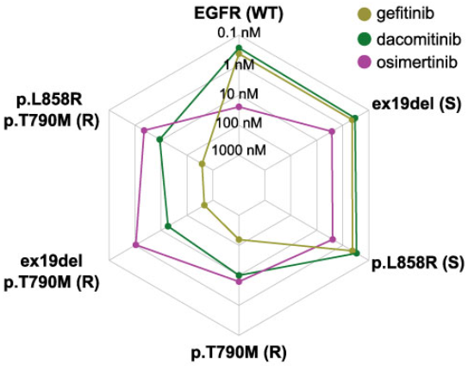
EGFR kinase mutations and drug sensitivity
The first (gefitinib) and second (dacomitinib) generation EGFR inhibitors are sensitive to EGFR (WT) and the exon 19 deletion (ex19del).
The T790M mutation is the most commonly observed mechanism of resistance.
The third generation EGFR inhibitor (Osimertinib) is specifically designed to target the T790M mutation.
Kooijman et al. (2022). Front. Oncol., 12:953013
Sino Biological, Inc.

Slide 27
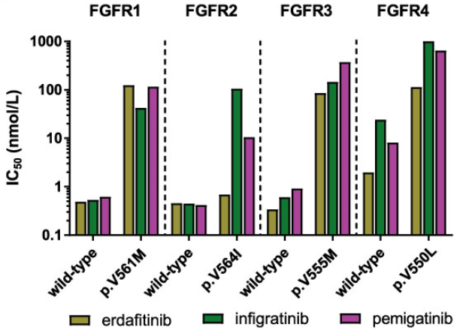
FGFR kinase mutations and drug sensitivity
The sensitivity of FGFR inhibitors varies between WT and mutant forms.
Acquired resistance mutations are a common resistance mechanism to FGFR inhibitors.
Kooijman et al. (2022). Front. Oncol., 12:953013
Sino Biological, Inc.

Slide 28
Structures of recombinant kinases in drug design
Require highly pure recombinant kinases for structure studies.
Both X-ray crystallography and cryo-electron microscopy (Cryo-EM) are suitable techniques.
Over 300 unique kinase structures have been determined and are available in the Protein Data Bank (PDB).
Structure analysis is essential for designing new drugs, and optimizing their properties for improved efficacy and selectivity.
Bai X.C. , et al. (2015). Nature Methods, 12(1): 29-35
Brian A et al. (2023). Biochemical Journal 480:1331
Sino Biological, Inc.
Notes:
X-ray crystallography offers atomic-level resolution and detailed structure information but requires crystallization
Cryo-EM enables visualization of proteins in their native state without the need for crystallization
312 kinase at least has one crystal structure available in PDB

Slide 29
Examples of kinase structure-based drug development
Compound Name | Target Kinase(s) | Therapeutic Indications | Notable Structural Insights | References
Imatinib (Gleevec) | BCR-ABL | Chronic myeloid leukemia | Designed using the structure of the ABL kinase domain | Druker, B.J. et al. (2001). N Engl J Med, 344(14): 1031-1037.
Gefitinib (Iressa) | EGFR | Non-small cell lung cancer | Based on the structure of the EGFR kinase domain | Hynes, N.E., & Lane, H.A. (2005). Nat Rev Cancer, 5(4): 341-354.
AZD9291 (Osimertinib) | EGFR | Non-small cell lung cancer | Targeting resistance mutations using structural insights | Yu, H.A. et al. (2013). Cancer Discov, 3(12): 1404-1411.
Dasatinib (Sprycel) | BCR-ABL, Src family kinases | Chronic myeloid leukemia, other cancers | Designed using insights from BCR-ABL and other tyrosine kinases | Shah, N.P. et al. (2004). Cancer Cell, 6(3): 313-325.
Lapatinib (Tykerb) | EGFR, HER2 | Breast cancer | Developed from structural data of EGFR and HER2 kinases | Geyer, C.E. et al. (2006). J Clin Oncol, 24(18): 2786-2792.
Sino Biological, Inc.
Notes:
X-ray crystallography offers atomic-level resolution and detailed structure information but requires crystallization
Cryo-EM enables visualization of proteins in their native state without the need for crystallization

Slide 30
Applications of recombinant kinases
Application areas | Description | References
Research tools | Study signaling pathways, cellular processes, and protein interactions in detail. | Zhang et al. (2016). Nat Rev Drug Discov, 15(6): 379-396
Drug development | Help in screening potential kinase inhibitors for therapeutic use. | Cohen (2002). Nat Rev Drug Discov, 1(2): 123-124.
Structure studies | Help to elucidate mechanisms and guide drug design efforts. | RCSB PDB. (n.d.). Retrieved from RCSB PDB. Billeter et al. (2005). Curr Opin Struct Biol, 15(1),:24-30.
Antibody production | Used as antigens to produce antibodies for diagnostics and treatment of diseases. | Lee, T.et al. (2019) Nature Reviews Immunology, 19: 30-45
Diagnostics | Employed in assays to detect specific kinase activity, or identifying kinase mutations. | Chen, S. et al.(2023) Journal of Clinical Pathology, 76: 150-160
Protein standards | Serve as standards in assays, ensuring the accuracy and reliability of measurements. | Riddell et al. (2019). J Immunol Methods, 467: 25-32.
Sino Biological, Inc.

Slide 31
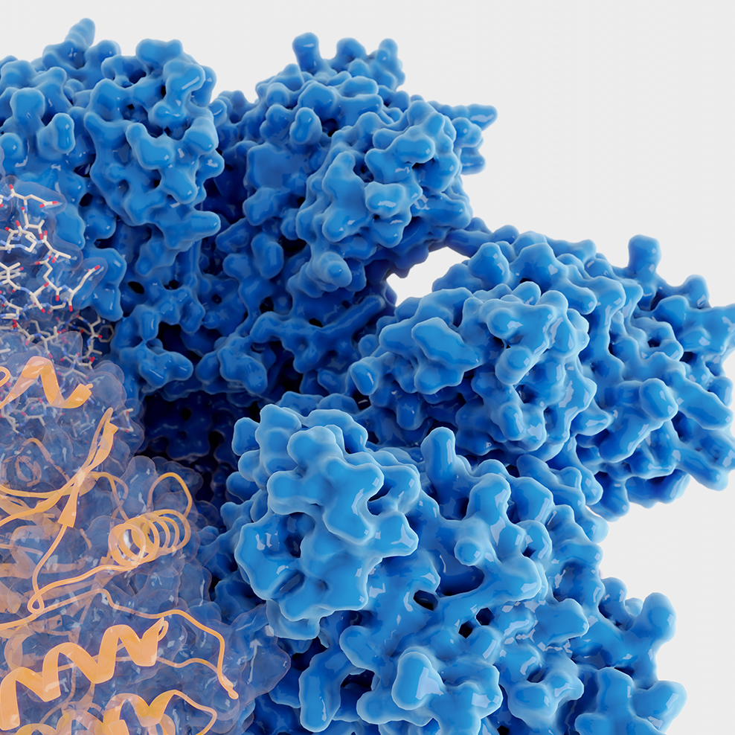
Opportunities and challenges of kinase studies
Up to the article submission in May 2023:
448 kinases have assays available;
312 kinases have crystal structures;
129 kinases have inhibitor molecules;
63 kinases are targets of FDA approved drugs;
Opportunities are waiting for your study, exploration, and discovery.
Brian A et al. (2023). Biochemical Journal 480:1331
Sino Biological, Inc.

Slide 32


The World Leader in Kinases
Contact Us:
Sino Biological, Inc.
Address: Building 9, Jing Dongbei Technology Park, No.18 Kechuang 10th St, BDA, Beijing, 100176, P.R.China
Tel: 400-890-9989
Email: order@sinobiological.com
Website: cn.sinobiological.com
Thank you!
Questions?
Follow us on WeChat!
Sino Biological, Inc.

