Slide 1
NCE 2 Lesson 32
Shopping made easy

Slide 2
New words and expression
once /wʌns/ adv. 曾经，以前
temptation /tempˈteɪʃn/ n. 诱惑
article /ˈɑːtɪkl/ n. 物品，东西
wrap /ræp/ v. 包裹
simply /ˈsɪmpli/ adv. 仅仅
arrest /əˈrest/ v. 逮捕

Slide 3

once
once /wʌns/ adv. 一次，一旦，曾经，以前
once upon a time 曾经

Slide 4
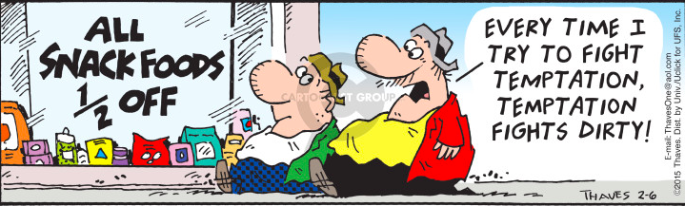
temptation
temptation /tempˈteɪʃn/ n. 诱惑
The temptation of food 美味的诱惑

Slide 5

article
article /ˈɑːtɪkl/ n. 文章， 物品，东西
E.g. I read an article about health this morning.
今早我读了一篇有关健康方面的文章。

Slide 6

wrap
wrap /ræp/ v. 包裹
wrap the gift
包装礼物

Slide 7
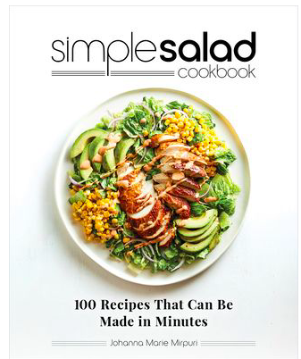
simply
simple /ˈsɪmpl/ adj. 简单的
simply /ˈsɪmpli/ adv. 仅仅
E.g. You can make salad simply by blending /ˈblendɪŋ/ the vegetables and salad dressing.
你只需把蔬菜和沙拉酱混合就可以做沙拉。

Slide 8

arrest
arrest /əˈrest/ v. 逮捕
E.g. The police arrested her for drinking and driving.
她因酒后驾车被警察拘捕。
-Cambridge Dictionary

Slide 9
Who was the thief?

Slide 10
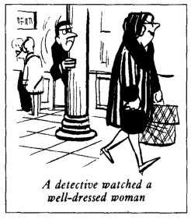
Text
People are not so honest as they once were. The temptation to steal is greater than ever before - especially in large shops. A detective recently watched a well-dressed woman who always went into a large store on Monday mornings. One Monday, there were fewer people in the shop than usual when the woman came in, so it was easier for the detective to watch her. The woman first bought a few small articles. After a little time, she chose one of the most expensive dresses in the shop and handed it to an assistant who wrapped it up for her as quickly as possible. Then the woman simply took the parcel and walked out of the shop without paying. When she was arrested, the detective found out that the shop assistant was her daughter. The girl 'gave' her mother a free dress once a week!
well-dressed 穿着入时的，这是复合形容词
than usual 比平常
as...as possible 尽可能......
without paying 没有付款，
这里介词短语作状语，表示方式；其中的动名词paying作介词without的宾语

Slide 11
Grammar: 不定式 to do
动词不等式( to + 动词) : 指动词中的一种非谓语动词形式（分词和动名词也属于非谓语动词形式)。
动词不定式可作谓语之外的任何句子成分；因有动词属性, 可有自己的宾语、状语；没有直接主语，使动者(动词的使用者)称为其逻辑主语。
作主语：
To go there by bike will take us half an hour. 骑自行车到那儿将花费我们半个小时。
it作形式主语(先行词), 把实际主语（后面的不定式短语）置于句后，如：
So it was easier for the detective to watch her. 因此，侦探比较容易监视她。
作宾语: 一些动词后只能跟不定式作宾语，例如：appear, ask, decide, fail, plan, prepare, happen, hope, learn, manage, want, seem, tend, wish等
E.g. He wants to go swimming tomorrow. 他明天想去游泳。
Notes:
参考：百度百科：动词不定式

Slide 12
Grammar: 不定式 to do
作补语
1) 动词+宾语+to do：The teacher will not allow kids to play on the street.
2) to + be 的不定式: We consider Tom to be one of the best students in our
class.
3) to be +形容词: The book is believed to be very interesting.
4) there be+不定式：We didn t expect there to be so many people there.
作状语：
原因状语: John is happy to see his friends. 约翰看到他的朋友很高兴。
目的状语: to do, in order to, so as to, so(such) ... as to (如此......以便......): She worked hard to pass the exam.
结果状语: to do, only to do (表示出乎意料等结果）enough...to...(足够……去做), too...to...(太……以致不能……), 等。
She is too young to go to school.
Notes:
知乎：动词不定式作状语

Slide 13
Grammar: 不定式 to do
作表语:
E.g. The goal is to throw the basketball into the basket.
目标是把篮球投进篮筐里。
作定语:（不定式作定语时，要置于被修饰的名词或代词之后，称为“后置定语”）
E.g. The tempatation to steal is greater than ever before. 偷窃的诱惑力比以往任何时候更强烈。

Slide 14
Grammar: 比较状语从句
状语从句(Adverbial clause)：从句在主从复合句中用作状语(即副词，修饰形容词，动词或句子），常用的有时间、地点、原因、条件、目的、结果、让步状语从句。
比较状语从句: 常用于形容词和副词的原级、比较级的句子之中。
原级：as…as（和……一样），not so（as）…as …（不如......那样......)；
E.g. Tom is as tall as his brother (is).
E.g. People are not so honest as they once were. 人们不再像以前那样诚实了。
比较级：than, more…than(更), the 比较级 … the 比较级 …, no … more than
E.g This apple is bigger than that one (is). 这个苹果比那个大。
E.g. The more I practice, the more I learn. 我练习的越多，学到的越多。
Notes:
参考：沪江英语：状语从句

Slide 15
参考译文
人们不再像以前那样诚实了。偷窃的诱惑力比以往任何时候都更强烈 -- 特别是在大的商店里。一名侦探最近注意上了一位穿着讲究的妇女，她总是在星期一上午进入一家大商场。有一个星期一，当这位妇女走进这家商场时，里面的人比往常少，因此，侦探比较容易监视她。这位妇女先是买了几样小商品。过了一会儿，她又选了商场里最昂贵的一件衣服，把它递给了售货员。那售货员以最快的速度为她包好了衣服。然后，那妇女拿过包就走出了商场，根本没有付钱。她被逮捕后。侦探发现原来那售货员是她的女儿。那姑娘每星期“送”她母亲一件免费的衣服!

