Slide 1
R·九年级下册
Unit 12
Life is full of the unexpected.
Section A 1a-2d

Slide 2
Learning objects
By the end of the class, you will be able to …
1. Learn to use new words and expressions:
unexpected backpack oversleep by the time…
2. Learn to understand and narrate past events.
3. Grasp the listening skills and the ability of
narration about what you had done in the past.

Slide 3
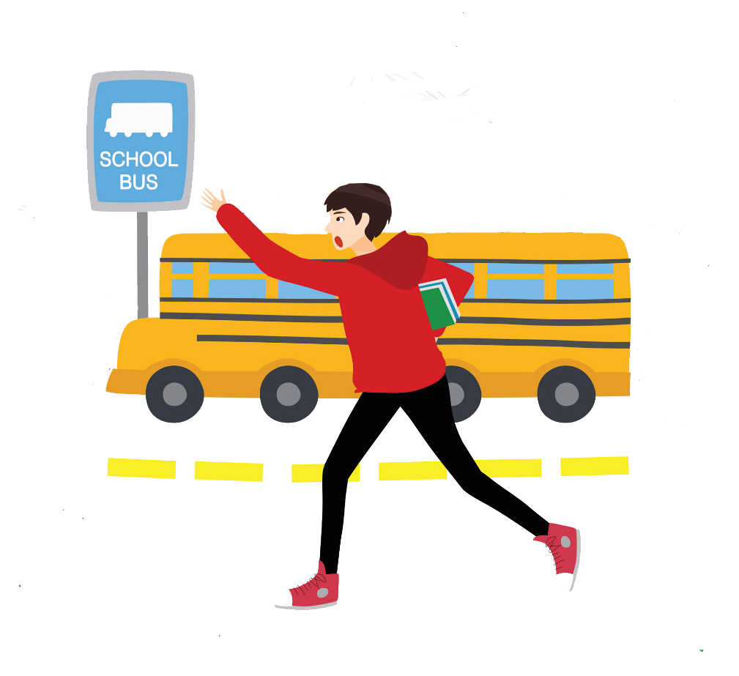
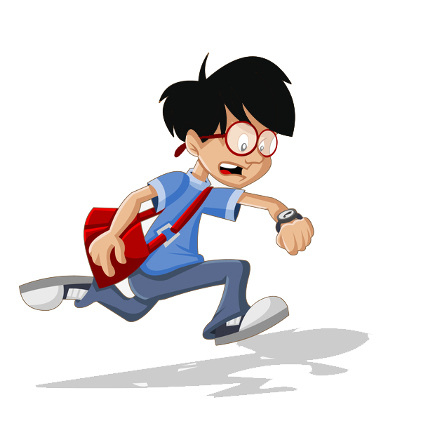
Lead-in
What unexpected situations had you once met in your life?
be late for school
miss the bus

Slide 4
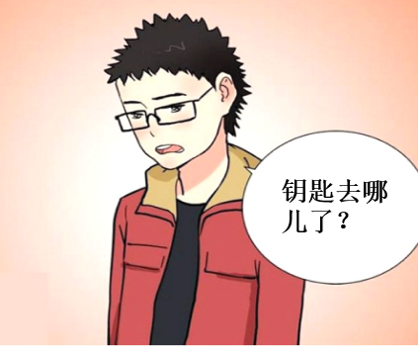
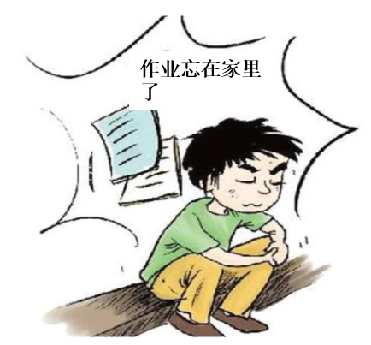
lose the keys
leave the homework at home

Slide 5
Brainstorm
Life is full of the unexpected.
…
be late for school
be knocked off
miss the bus
come across an car accident
Unexpected events
lose the keys
power cut
leave the homework/schoolbag at home

Slide 6
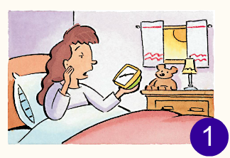
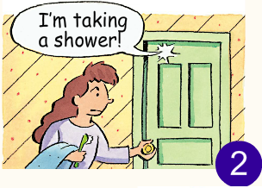
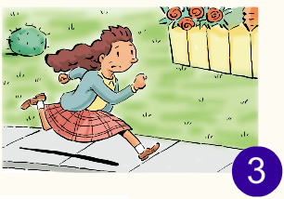
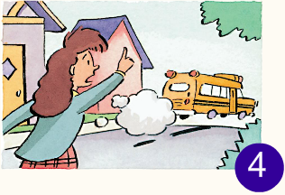
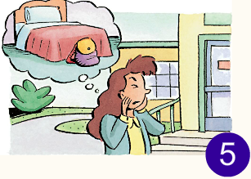
Q: Did the girl have a good day or a bad day?
1a
Look at the pictures. What happened to the girl?

Slide 7
Work in groups
Discuss and predict what is going on in each picture.
Choose one student to predict the events with sentences.

Slide 8
Let’s predict
The girl was in her bed realizing that she ________________.
had overslept
She wanted to _______________ but someone was there taking a shower.
use the bathroom

Slide 9
She ran along the pavement, most likely heading to _____________.
the bus stop
She tried to catch the bus, but it ___________.
had just left
She got to school and realized she ____________________________.
had left her backpack at home

Slide 10

Listen to Mary talking about her morning. Complete the sentences.
1b
1. By the time I got up, my brother ____
already ______ in the shower.
2. By the time I got outside, the bus ____
already ____.
3. When I got to school, I realized I ____
____ my backpack at home.
had
过去完成时：表示在过去某个时间或某个动作之前发生的动作或存在的状态。
结构：had+过去分词
标志词：by the time+一般过去时的句子；
when/ before引导的一般过去时的
时间状语从句
gotten
had
left
had
left

Slide 11
Tapescripts
by the time 意为“在……以前”，引导时间状语从句，若从句用一般过去时，主句常用过去完成时。
e.g. By the time Lily got home, her friends
had left.
Boy:
Mary:
Boy:
Mary:
Hi, Mary. You look so tired.
I am. I had a bad morning.
Really? What happened?
睡过头，睡得太久
Well, first of all I overslept. By the time I got up, my brother had already gotten in the shower.
had already gotten
①

Slide 12
Boy:
Oh, what a pain!
So, after he got out of the shower, I took a quick shower and got dressed. But by the time I went outside, the bus had already left.
Oh, no!
Oh, yes! So I ran all the way to school. But when I got to school, I realized I had left my backpack at home.
No wonder you look stressed.
Mary:
had already left
②
Boy:
Mary:
had left
③
Boy:

Slide 13
Take turns being Mary. Look at the pictures
above and talk about what happened this morning.
1c
A：What happened?
B：I overslept. By the time I got up, my
brother had already gotten in the shower.

Slide 14
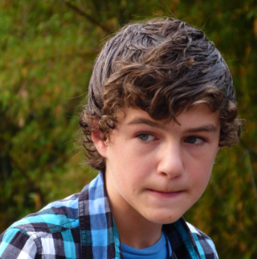

The best actor/actress
One student acts as Mary and the other one as her classmate or friend. Make a dialogue lively.
Hi, Mary. You look a little down. What happened?
I overslept. By the time I got up, my brother had already gotten in the shower.
Oh, you must feel awful at that time.

Slide 15
Then I took a quick shower and got dressed. But by the time I went outside, the bus had already left.
So how did you get to school?
So I ran all the way to school. But when I got to school, I realized I had left my backpack at home.
No wonder you look stressed. I feel sorry for you.

Slide 16

Fast response
Listen and judge things that are good or bad. If things are good, please stand up. If things are bad, all the students remain on the seats. You need to make a response within 2-5 seconds.

Slide 17
When I got up, my mother had already made breakfast for me.
When we reached the cinema, the movie had begun.
By the time I got back home, I realized I had left my schoolbag at the playground.
Before I was laid off, I had found a new job.
By the time Mary arrived at the airport, the plane had already taken off.
Before I got off work, the downpour had begun.
By the time the bell went off, I had filled my answers on the test paper.

Slide 18
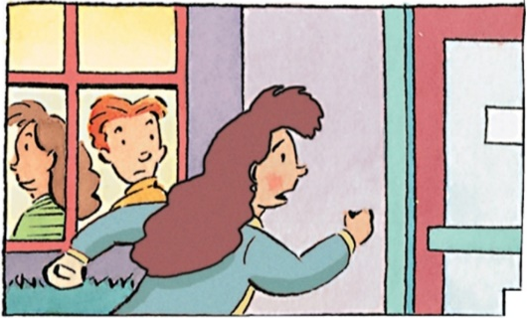
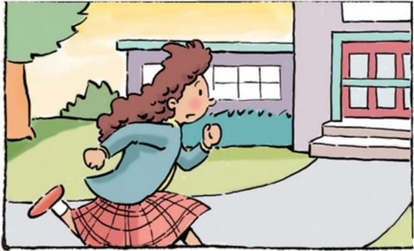
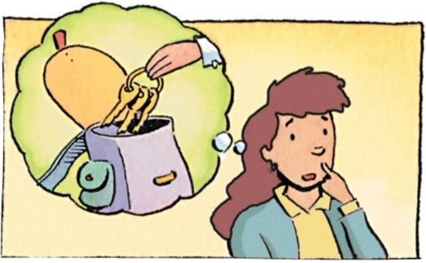
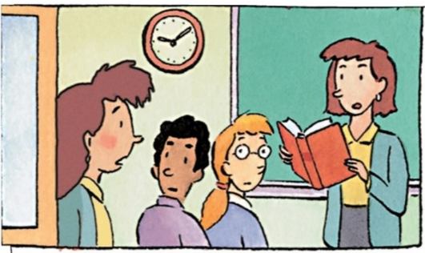
Before listening
Where is Mary in the pictures?
Is anything good or bad happening to her?
What do you think it is about? Just give a reasonable prediction.

Slide 19
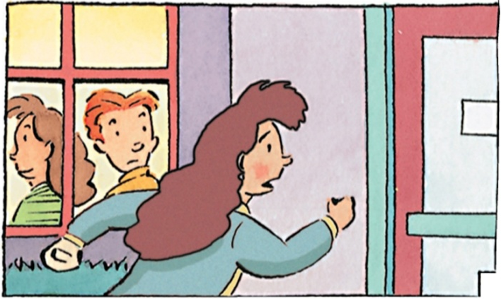
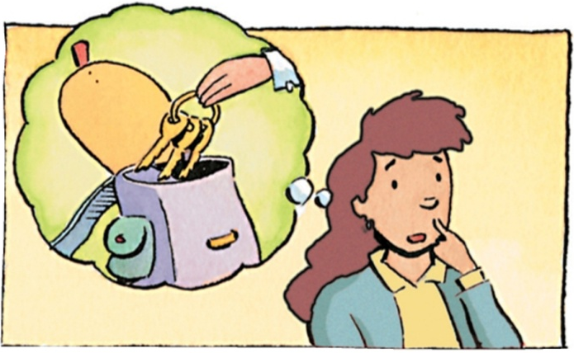


2a
Listen to Mary continue her story. Number the pictures [1-4] in the correct order.
3
1
2
4

Slide 20
2b
Fill in the blanks with the correct forms of the verbs in brackets. Then listen again and check your answers.
1. When I ____ (get) home, I realized I ________
(leave) my keys in the backpack.
got
had left

Slide 21
2. By the time I ____ (get) back to school, the bell
_________ (ring).
3. By the time I _________ (walk) into class, the
teacher ____________ (start) teaching already.
got
had rung
walked
had started

Slide 22
Listening materials
Boy:
Mary:
Boy:
So then what did you do, Mary?
Well, I ran home to get my backpack. But when I got home, I realized I had left my keys in the backpack.
You’re kidding!

Slide 23
Mary:
Boy:
Mary:
So I ran back to school without my keys or my backpack. But by the time I got back to school, the bell had rung.
Oh, no!
And by the time I walked into class, the teacher had started teaching already. She asked for our homework, but of course I didn’t have it.

Slide 24
Retell the story
get up late
took a shower
ran to catch the bus

Slide 25




6
left backpack
at home
left keys in the backpack
Bus had just left.
7
8
9
The bell had rung.
had started teaching
ran back to school

Slide 26
2c
Make up an ending for the story and share it with your partner.
The teacher looked at Mary and ...
The teacher looked at Mary and asked her if she had finished the homework. Mary said she had finished but left it at home. Then after class she told her classmates the unexpected things she met this morning but everyone thought that couldn’t be true. What an awful day it is!

Slide 27
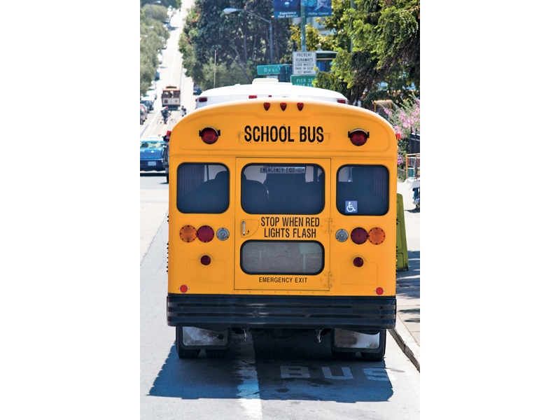
2d
Look at the picture. What can you see? Can you guess what the dialogue is about?
Give some key words.
school bus, being late for school, getting up late.

Slide 28
Close the book and listen, then answer questions.
1. Why was Kevin late for school?
Because his alarm clock didn’t go off.
2. What time was it when Kevin woke up?
It was already 8:00 a.m.
3. Did he catch the bus?
4. How did Kevin go to school?
Carl’s dad gave him a lift in his car.
Listening tips: highlight the key information of the questions and grasp the key words about the questions.
No, he didn’t.

Slide 29
Let’s analyze the conversation.
Matt:
Kevin:
Matt:
Kevin:
Why were you late for class today, Kevin?
My alarm clock didn’t go off! I kept sleeping, and when I woke up it was already 8:00 a.m.!
Oh, no!
So I just quickly put on some clothes and rushed out of the door.
（闹钟）发出响声
冲出/奔出……

Slide 30
Matt:
Kevin:
Matt:
Kevin:
Matt:
You didn’t eat breakfast?
No, I didn’t even brush my teeth or wash my face! But before I got to the bus stop, the bus had already left.
Then how did you get here?
Luckily, Carl’s dad saw me on the street and gave me a lift in his car.
Well, at least by the time you got to school, you were only five minutes late for class.
give sb. a lift 意为“捎某人一程”
=give sb. a ride/offer sb. a ride。

Slide 31
Listen again and fill in the blanks.
Matt:
Kevin:
Matt:
Kevin:
Why were you late for class today, Kevin?
My alarm clock didn’t ______! I kept sleeping, and when I ________ it was already 8:00 a.m.!
Oh, no!
So I just quickly _______ some clothes and ____________ the door.
go off
woke up
put on
rushed out of

Slide 32
Matt:
Kevin:
Matt:
Kevin:
Matt:
eat breakfast
You didn’t _______________?
No, I didn’t even ______________or ______
__________! But before I ______ the bus stop, the bus had already left.
Then how did you get here?
Luckily, Carl’s dad saw me on the street and ______________ in his car.
Well, at least by the time you got to school, you were only five minutes late for class.
brush my teeth
wash
my face
got to
gave me a lift

Slide 33
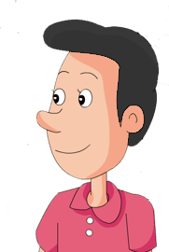
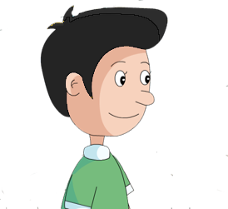
Role-play
Role-play the conversation and retell what happened in the conversation.
…
…

Slide 34
Why were you late for
class today, Kevin?
My alarm clock didn’t get off! I kept sleeping, and when I woke up it was already 8:00 a.m.!

Slide 35
Oh, no!
So I just quickly put on some clothes and rushed out of the door.
You didn’t eat breakfast?

Slide 36
No, I didn’t even brush my teeth or wash my face! But before I get to the bus stop, the bus had already left.
Then how did you get here?

Slide 37
Luckily, Carl’s dad saw me on the street and gave me a lift in his car.
Well, at least by the time you got to school, you were only five minutes late for class.

Slide 38
What happened to Kevin? Try to describe Kevin’s bad day with your own words.
On that morning, Kevin’s clock didn’t go off. When he woke up, it was already 8:00 a.m. He just put on some clothes and rushed out of the door without breakfast. But he didn’t catch up the bus. Luckily, Carl’s dad gave him a lift and when he got to school, he was only five minutes late for class.

Slide 39
Summary
How to narrate a series of events in a conversation:
1. By the time I got up, my brother had already
gotten in the shower.
2. When I got to school, I realized I had left my
backpack at home.
3. Before I got to the bus stop, the bus had already left.

Slide 40
Homework
1. Revise the new words and phrases and
be able to do the dictation.
2. Read and retell the conversation in 2d.
3. Do the exercises.（见“状元成才路”系
列丛书《创优作业》对应课时作业）

